Slide 1
BCBS 239 Implementation
Dummies guide to out of cycle risk data aggregation and risk reporting in response to an ad hoc scenario or stress event

Slide 2
Agenda
Objectives
Risk data aggregation and risk reporting under stress in the context of BCBS 239
Definition of out of cycle reporting
The crisis process
Key requirements for the process
Typical ad hoc scenarios and stress events
Defining requirements: Credit Risk example
How to document out of cycle reporting requirements

Slide 3
Objectives
Define what out of cycle reporting means.
Define requirements for out of cycle reporting:
The process: from trigger to production of reporting requirements
What: current or additional metrics / critical data elements, and dimensions for impacted risk types (credit, market and liquidity risk)
When: frequency and timing of risk data aggregation and risk reporting
How: business lineage, processes and systems (ideally the same strategic architectural solutions in place for BAU reporting), together with compensating controls
Who: roles and responsibilities to produce ad hoc reports
Define acceptable trade-offs:
Depending on the nature / urgency of the request, it should generally be possible to make trade-offs between timeliness and accuracy of ad hoc and stress reporting.
Trade-offs made should be described in the limitations report accompanying the report.
Define typical ad hoc scenarios and stress events under which out of cycle reporting will be required.
Define how out of cycle reporting requirements should be documented.

Slide 4
Risk data aggregation and risk reporting under stress in the context of BCBS 239
Principle 2
Data architecture and IT infrastructure to fully support RDARR practices not only in normal times but also during times of stress or crisis, while still meeting the other Principles.
Generate accurate and reliable risk data (on largely automated basis to minimise probability of errors) to meet normal and stress/crisis reporting accuracy requirements.
Different types of data will be required at different speeds, depending on the type of risk, and certain risk data may be needed faster in a stress/crisis situation. Risk systems must be capable of producing aggregated risk data rapidly during times of stress/crisis for all critical risks.
Supervisors will review that the bank specific frequency requirements, for both normal and stress/crisis situations, generate aggregate and up-to-date risk data in a timely manner.
Generate aggregate risk data to meet a broad range of on-demand, ad hoc risk management reporting requests, including requests during stress/crisis situations, requests due to changing internal needs and requests to meet supervisory queries.
Establish accuracy and precision requirements that reflect the criticality of decisions based on this information, for both regular and stress/crisis reporting, including critical position and exposure information.
Increase the frequency of reports during times of stress/crisis.
Assess periodically the purpose of each report and set requirements for how quickly the reports need to be produced in both normal and stress/crisis situations.
Routinely test the ability to produce accurate reports within established timeframes, particularly in stress/crisis situations.
In times of stress/crisis all relevant and critical credit, market and liquidity position/exposure reports to be available within a very short period of time (sometimes immediately) to react effectively to evolving risks.
Principle 3
Principle 5
Principle 6
Principle 7
Principle 10

Slide 5
Definition of out of cycle reporting
Out of cycle reporting refers to reporting in the following circumstances:
Reporting in times of stress/crisis (systemic or idiosyncratic)
Systemic Stress
Market wide event that impacts the bank. The event may require reporting of new metrics or existing metrics on a more frequent basis.
Idiosyncratic Stress
This is an event that is bank specific.
Ad hoc reporting outside of BAU reporting
The business needs to ensure that the control requirements are met to enable data to be available at the required level of performance in situations ranging from normal to stress or crisis events.

Slide 6
Out of cycle and crisis reporting process
Trigger
Event
Risk Reporting Coordinator (RRC)
Risk Reporting Working Group
Report Consolidation and Review
Crisis/Stress event
Market wide
Internal
Crisis Management Command Centre (CMCC) (Business Resilience incorporated)
Assesses the situation and determine if it is a liquidity/ capital crisis event?
Assesses the situation and if there is a need for the Risk Reporting Working Group to meet
Assesses the situation in terms of:
What is required
Current or additional metrics
Dimensions for impacted risk types (credit, market and liquidity risk)
Critical data elements
How will it be obtained
Authoritative source
Other sources (assurance of reliability)
When is the information required
Up to date reporting (day & time)
Month in arrears (best available)
RRC consolidates information, ensuring it meets the initial requirement.
Reports presented to Risk Reporting Working Group for finalisation and submission.
Finalised reports provided to the Crisis Management Command Centre or requestor of the reports.
NO
YES
CMCC
YES
NO
Out of Cycle
Regulatory Request
(SARB/BASA)
Exco/Board request
Risk type(s) playbooks – as per slide 10
Informs
Out of cycle requestor
Follows Liquidity/ Capital Framework.
May require the recovery plan to be invoked
Informs specific risk type of the information required and timing

Slide 7
Key requirements for the process
Creation of Risk Reporting Working Group that is mandated by Exco
Clearly defined Terms of Reference for the Risk Reporting Working Group
Senior Representatives from the following areas:
Enterprise Risk
Credit Risk
Capital Risk
Liquidity Risk
Market Risk
Finance
Treasury
Legal risk
Operational Risk
Conduct and Reputational Risk
Model Risk
Relevant Data owners, Process owners, Report owners and Governance and Control leads from each of these areas to be included.
Appointment of Risk Reporting Coordinator

Slide 8
Typical ad hoc scenarios and stress events
# | Example scenario
 | Event | Example scenario narrative | Impact | Risk types impacted | Governed by | Monitored and managed through
1 | Market Wide Event Macro-economic stress event | South Africa’s major trading partners experience slower economic growth and the impact is severe as it coincides with the local economy’s receding growth and entering a deep recession which has the effect of weak business and consumer confidence, anaemic employment growth, high consumer indebtedness and weak fixed income growth. State owned Entities undergo no reform and further deterioration on the fiscal position is amplified by the government’s announcement of a higher than expected budget shortage. The debt to GDP peaks near 60% and all rating agencies have downgraded South Africa two notches below investment grade. Consequently South African bonds are excluded from global indices and the rand is vulnerable to passive foreign investor selling. | Cost to income ratio deteriorates. Large impairment charges CET1 ratio breaches point of failure. Significant increase in CET1 capital required to restore CET1 ratio to minimum capital ratio %. | Credit Risk Liquidity & Funding Risk | GRCMC BERC ATC | BU and risk type crisis playbooks / scenarios Enterprise risk playbooks / scenarios BAGL Recovery Plan Crisis Reporting working group
2 | Idiosyncratic stress Liquidity stress event | In this stress Absa assume hackers have managed to gain access to Absa clients’ accounts by spreading malware through the core banking system. The malware has erased transaction history and has allowed the hackers to transfer funds from clients’ cheque, savings and notice accounts to fictitious accounts. Clients across the bank have been inundating call centres to determine why their account balances are not reflecting accurately. Social media has also seen a surge in the number of client complaints relating to incorrect account balances. Due to the above, combined with the reputational concerns related to the Bank’s separation from Barclays Plc, clients have lost faith in Absa and are trying to withdraw their remaining funds as rapidly as possible resulting in a run on the bank. | A severe decrease in deposits due to customers as well as a decrease in wholesale funding. A reduction in inflows due to lower loans and advances balance are repaid and loans are not renewed and no new loans are extended. There is a significant decrease in the High Quality Liquid Assets. | Liquidity & Funding Risk Operational Risk (fraud incidents) | GRCMC BERC ATC | BAGL Recovery Plan Early warning indicators Crisis Reporting working group

Slide 9
Typical ad hoc scenarios and stress events
# | Example scenario
 | Event | Example scenario narrative | Impact | Risk types impacted | Governed by | Monitored and managed through
3 | Idiosyncratic stress (Other examples) | Internal collusion and Fraud Ineffective management, system failure Process failure Rogue traders | Reputational risk Real financial losses Can result in a liquidity stress event. | Operational Risk Liquidity and Funding Risk Reputational Risk | GRCMC BERC ATC | CPA process Operational risk controls BAGL Recovery Plan Early warning indicators
4 | Idiosyncratic stress (Credit specific) | Single large corporate exposures within Absa Bank defaults, resulting in significant specific impairments. | Losses lead Absa to more vulnerable position as its available financial resources are significantly impacted. | Credit Risk Operational Rsk | GRCMC BERC | Credit and Operational Risk playbooks / scenarios Enterprise risk playbooks / scenarios
5 | Adhoc Scenario | SARB request disclosure in terms of all Kenyan exposures in the Agriculture sector. Information requested is exposure and respective Basel III capital on the exposures. | N/A | Credit Risk Capital Risk | GRCMC BERC | Crisis Reporting working group
6 | Adhoc Scenario | Exco request all exposure and capital information to specific corporates with negative media attention | N/A | Credit Risk Capital Risk | GRCMC BERC | Crisis Reporting working group

Slide 10
Defining requirement: Credit Risk example
What |  | When | How |  |  | Who | Trade offs
The typical requests expected to be centered around exposure to individual customers, industries or geographies, e.g.: Provide a view of the bank’s exposure to Oil & Gas in West Africa. Provide a view of the bank’s trading exposure to European banks. Provide a view of the bank’s exposure to customer XYZ. Reporting of potential country risk exposure that the bank is facing under a country risk event also included in the base requirement, e.g.: Provide a view of the bank’s potential loss in the event of a country event in Ghana. |  | The aim is to have all metrics in scope for stress reporting available on a T+1 basis (by 8:00 JHB time). | In principle reporting under stress should be done out of the same data sources that are used for BAU reporting (ideally off the strategic architecture being put in place). |  |  | Ownership of the out of cycle metrics / CDEs and dimensions reported, and ownership and stewardship of the process(es) to produce the out of cycle reports | A number judged to be inaccurate in some respects could still be acceptable for reporting under stress (data/metric owner to make a decision).
Metrics / CDEs | Dimensions | Frequency and timing | Business lineage & processes | Systems | Controls | Roles and responsibilities | Trade offs
Wholesale credit exposure Total outstandings TFL Current Exposure | Industry Geography Customer Group | CIB: T+1 basis by 8:00 JHB time BB: At least previous month-end | Requests should be handled by BU Credit Risk Measurement areas, who will be responsible to document processes, and implement controls. | CIB’s credit exposure management systems (e.g. Algo Credit Limits for CIB SA) for daily monitoring. BB: BAU sources | Review of numbers by Data Stewards, and ultimate signoff by Data Owner. Reconciliation / manual checking against Regulatory data. | Sourcing of data: Data Stewards (Cdt Risk Measurement) Signoff: Data Owners | If accurate CIB exposure information is not available at T+1, the bank should fall back on the most recent available information (T-2 or, at worst, last available month-end). Last month end may be the BAU situation for CIB ROA.
Retail credit exposure Gross L&A | Product Geography | At least previous month-end |  | BAU sources
Country Exposure | Country of risk | T+1 basis by 8:00 JHB time |  | BAU sources |  |  | Most recent available information (T-2 or, at worst, last available month-end).

Slide 11
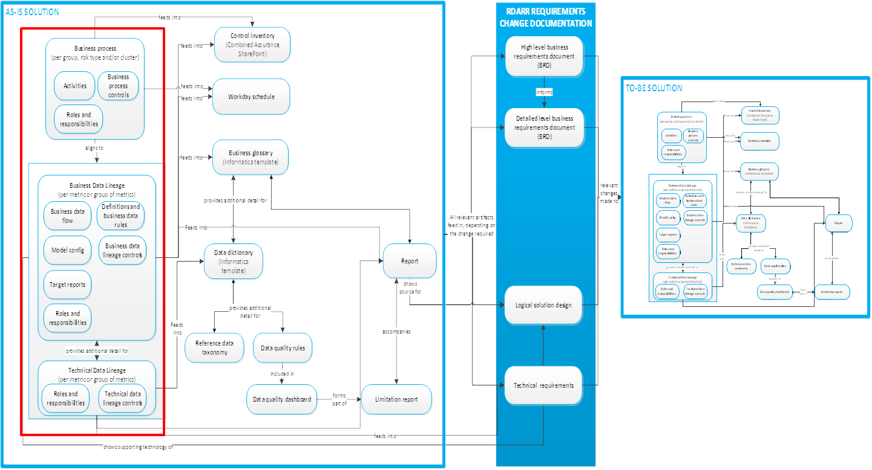
How to document out of cycle reporting requirements
Document aggregation and reporting processes, business lineage and technical lineage IF different from BAU processes and lineage.
Identify owners & stewards if different from BAU owners & stewards
Identify, document and implement additional controls if processes are different / manual.

