Slide 1
Voltron – Training
Internal Only

Slide 2
Index
1 |  | Introduction
2 |  | Taxonomy View
 | 2.1. | Taxonomies
 | 2.2. | Terms
 | 2.3. | Business Processes
 | 2.4. | View Details
 | 2.5. | Navigation Features
3 |  | Lineage View
 | 3.1. | Object Types
 | 3.2. | Data Flow
 | 3.3. | Linkages between the Taxonomy View and the Lineage View
 | 3.4. | Controls
4 |  | Template Completion Guide
5 |  | Certification For Owners and Stewards

Slide 3
Introduction
1

Slide 4
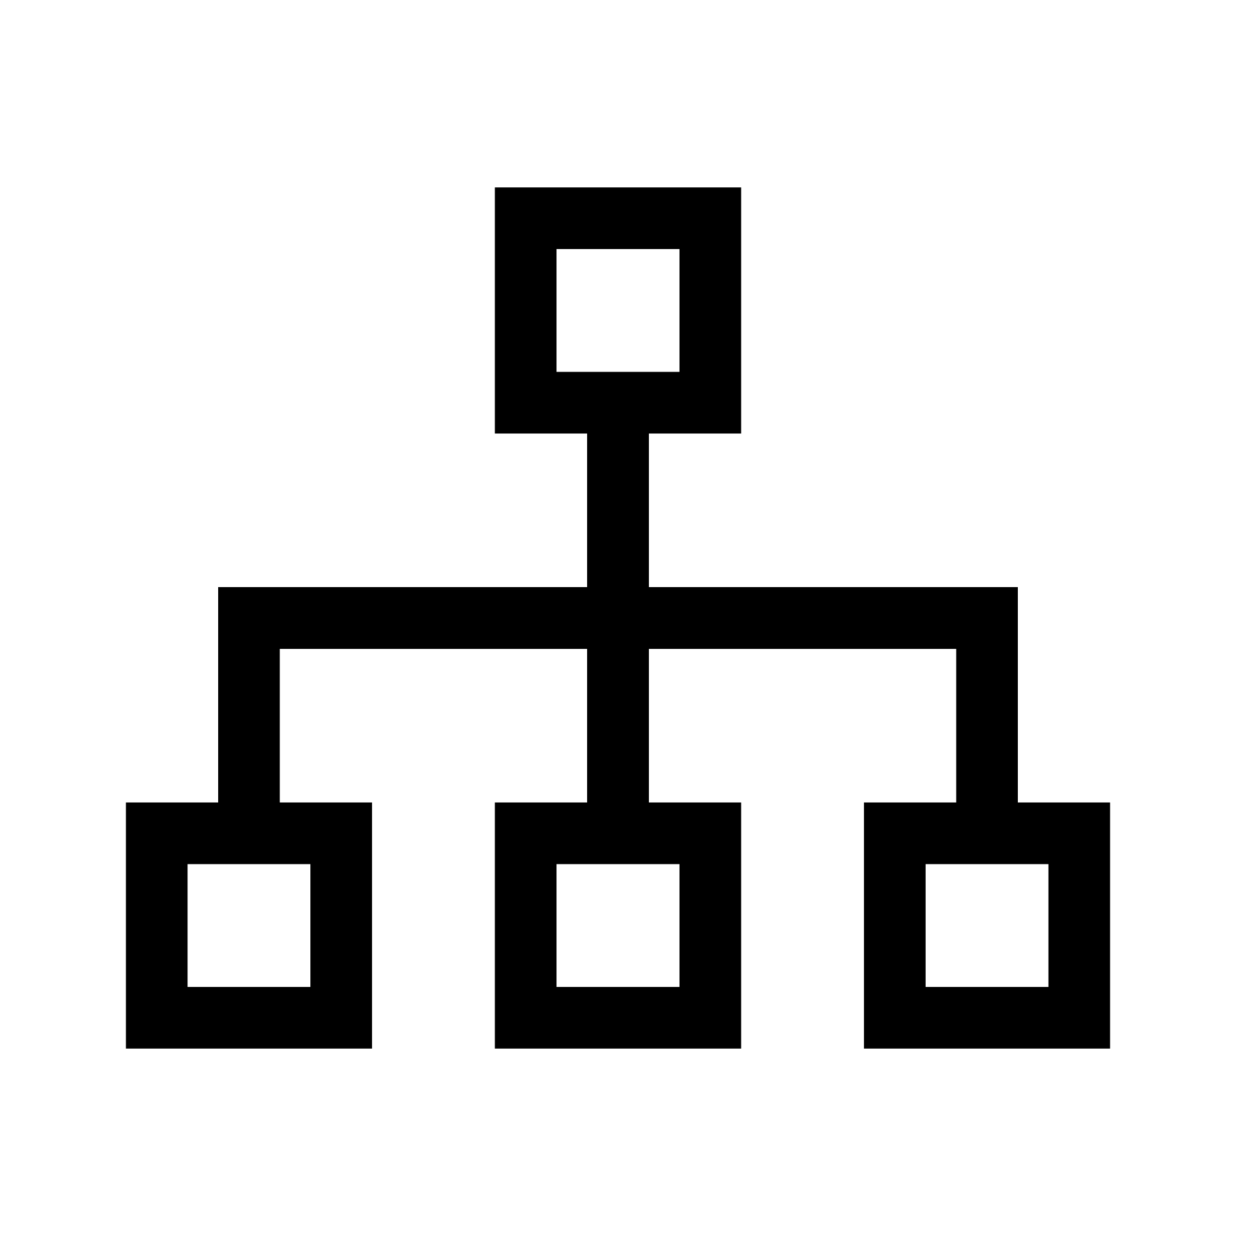




Voltron
Integrated Taxonomy
Business Glossary
Technical Metadata
Data Lineage
Data Ownership
Provides a view of Risk Data linked into a single structure representing the Enterprise Risk Management Framework
Contains Business Terms and their respective definitions
Contains information on systems and the data contained within them
Contains a view of all the systems within the solution landscape and details the data flow between them (includes a view of controls applied)
Links owners and stewards to data, systems, controls and processes and enables them to review and confirm their ownership
Ability to link and navigate between these Data Management Components

Slide 5
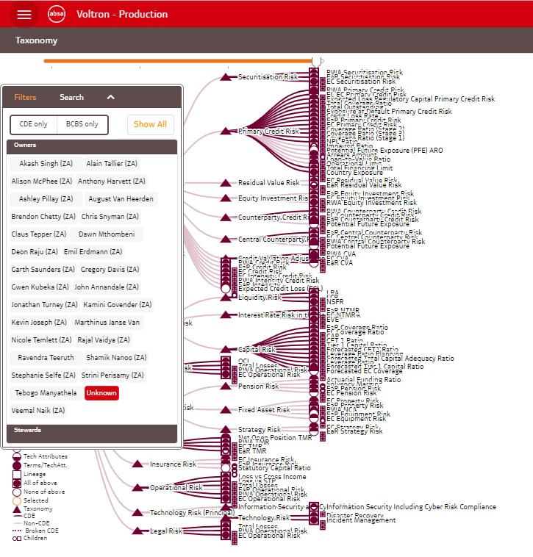
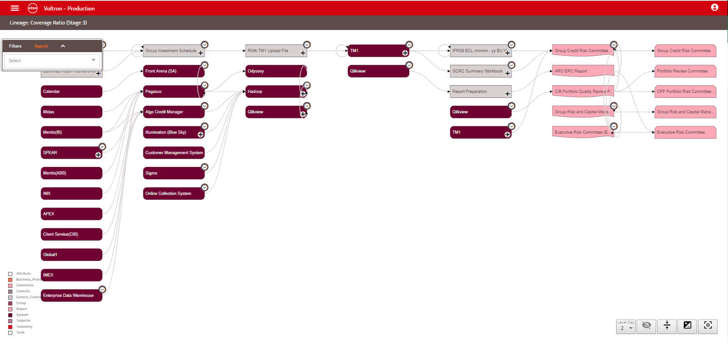
Taxonomy View
Lineage View
There are two main views in Voltron:
The taxonomy view:
Represents a view of business terms grouped into taxonomies
The lineage view:
Represents a view of how data flows through the physical data landscape

Slide 6
Taxonomy View
2

Slide 7
Taxonomies
2.1

Slide 8
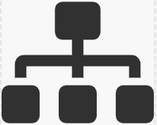

Taxonomy View
Lineage View
The taxonomy view contains two types of objects:
Taxonomies
Terms
Taxonomy
1. Taxonomies: A taxonomy is a high-level structure used to group data in ways that enriches or describes the data in the context of how it is used. These items are represented by triangles on the view.
Legend:
If the taxonomy triangle is filled, it means that there are lower level taxonomies or terms linked.
If it is not filled, it means there are no underlying taxonomies or terms.
E.g.
Filled
Not filled

Slide 9
Taxonomy View
Lineage View
Taxonomies can be broken down into other taxonomies to represent hierarchies present within business.
Taxonomy
Taxonomy
Taxonomy
For Risk data: The ERMF is used as the main taxonomy and then broken down into the principal risk types and then into the respective structures as defined by the risk type frameworks.
See next slide for current Risk taxonomy

Slide 10
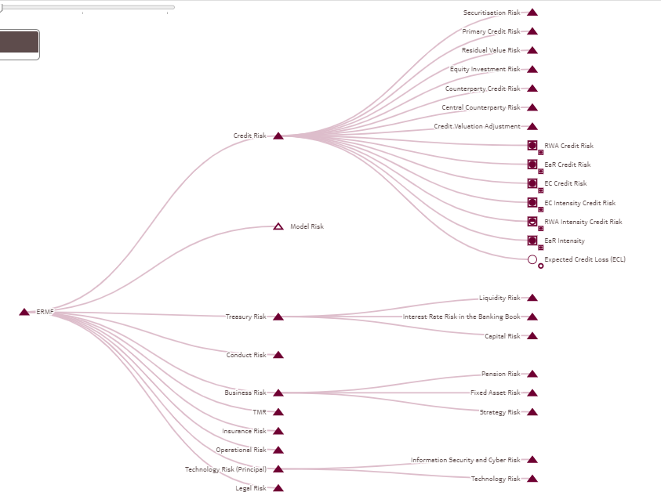

Risk Taxonomy on Voltron:
You can expand and collapse taxonomies on this view with a single click
Single Click

Slide 11
The Risk taxonomy is made up of 3 levels
Level 1:
The overarching Enterprise Risk Management Framework (ERMF)
Level 2:
The Principal Risk Types as defined in the ERMF
Level 3:
Sub Risk Types or Specialist Risk Types as defined in the relevant principal risk frameworks

Slide 12
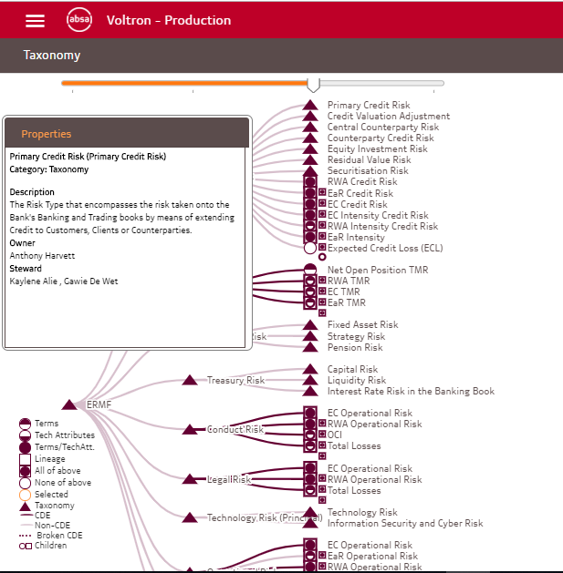

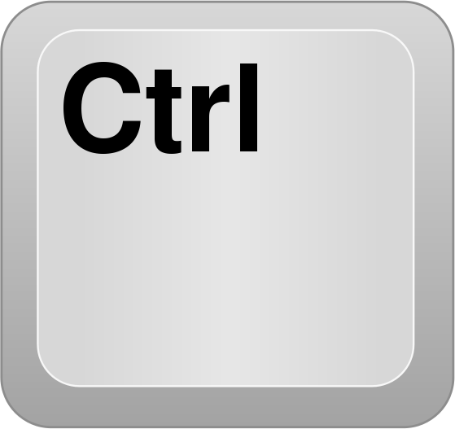

To view the properties for a taxonomy, you can hover on top of the item and the properties box will appear in the top left of the screen.
Hover
In order to lock the properties box, press Ctrl + L.
+

Slide 13
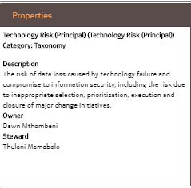
Taxonomy Properties:
Description
A detailed definition of the taxonomy
Owner
The person who owns the taxonomy and is accountable for the definition and maintenance of the taxonomy
Steward
The steward of the taxonomy. The person responsible for the definition and maintenance of the taxonomy.

Slide 14
Terms
2.2

Slide 15

Taxonomy View
Lineage View
2. Terms: Business concepts/data elements that are defined in business language as used in day to day operation.
Taxonomy
Term
Taxonomy
Taxonomy
Term
Terms are linked to taxonomies. This makes it easier to find relevant terms to a specific area.

Slide 16


Taxonomy View
Lineage View
Terms can further be broken down into other terms to indicate either another level of detail or to break a term up into its component parts
Taxonomy
Term
Term
Taxonomy
Taxonomy
Term
Term
Terms are represented by circles on the taxonomy view
E.g.
Further information is supplied about the term in the circles based on the legend that can be found at the bottom left of the screen. See next page for a detailed explanation

Slide 17

Term Legend Explained:
If the top half of the circle is filled, it means the term has been broken down into lower level terms
If the bottom part of the circle if filled, it means it has been linked to a system or an generic function. More on this later in the presentation
If the whole circle is filled, it means that the term has both lower level terms and a system/generic function linked
On the bottom left of each term icon there is a smaller icon representing whether any of the above information is present on the terms children
If a block surrounds the circle, it means that data flow (aka data lineage) has been captured for the term. More on this later in the presentation
If the circle is both filled and also has a block surrounding it, it means that all the elements mentioned above is present for the term
A term is highlighted in orange if it is selected by searching or filtering

Slide 18
Taxonomy View
Lineage View
Taxonomy
For Risk data:
The first level terms linked to the taxonomies usually represents key risk metrics. They are then broken down into the other metrics or critical data elements that are used to derive them.
Term
Term
Taxonomy
Taxonomy
Term
Term
See next slide for an example

Slide 19
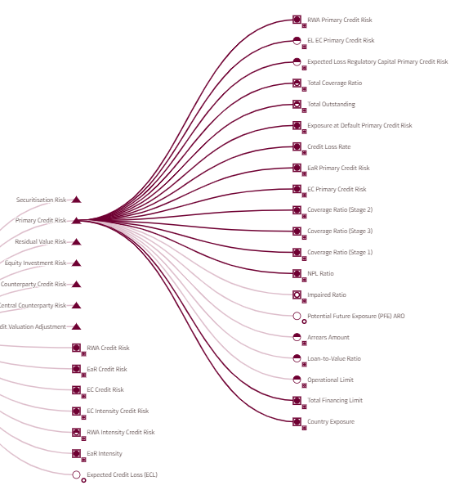

Here is an example of the key risk metrics that form part of Primary Credit Risk
From this view you can double click on a term to then navigate to further levels of breakdown.
E.g. See next slide for the Country Exposure Breakdown.
Double Click

Slide 20
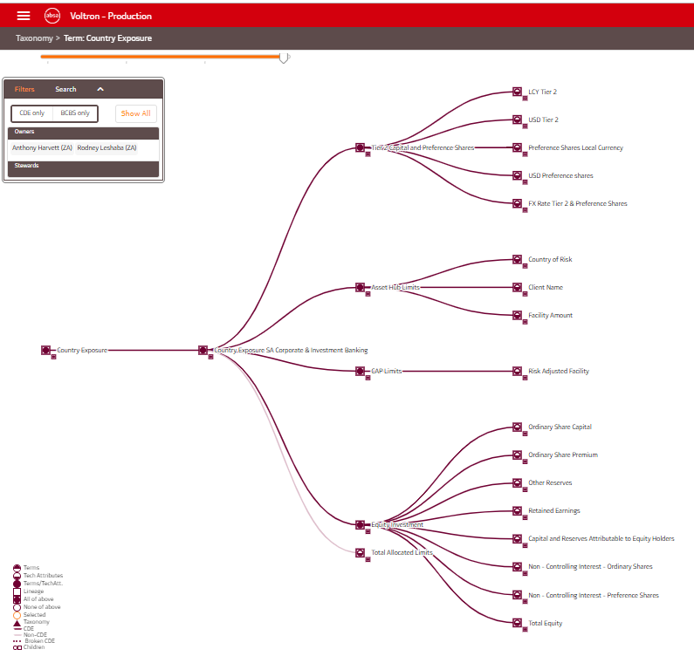
This is the Term Breakdown view for Country Exposure
You can expand and collapse terms on this view with a single click
Single Click

Slide 21
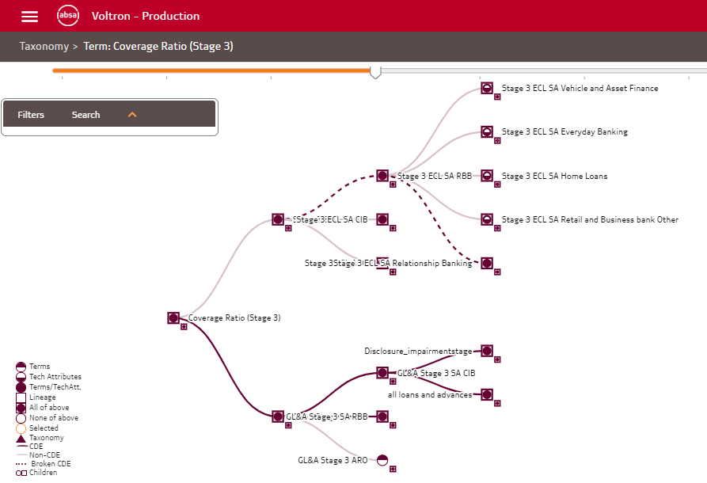
Critical Data Elements (CDEs)
Where a term has been identified as a CDE – it is linked into the taxonomy view with a bold line

Slide 22
Critical Data Elements (CDEs)
Where a term has been indicated as being a CDE and its parents are not indicated as being CDEs – it means that the CDE line is broken in the taxonomy. This is indicated the dotted line connections.
This is in all probability a Data Quality issue that needs to be addressed.

Slide 23
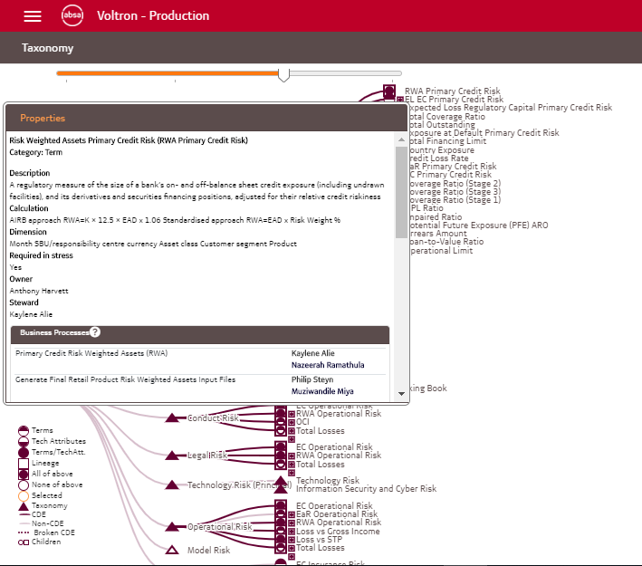
To view the properties for a term, you can hover on top of the item and the properties box will appear in the top left of the screen.
Hover
In order to lock the properties box, press Ctrl + L and then you are able to use the slider on the property box to view all the information.
+

Slide 24
Taxonomy Properties:
Description
A detailed definition of the taxonomy
Owner
The person who owns the taxonomy and is accountable for the definition and maintenance of the taxonomy
Steward
The steward of the taxonomy. The person responsible for the definition and maintenance of the taxonomy.

Slide 25
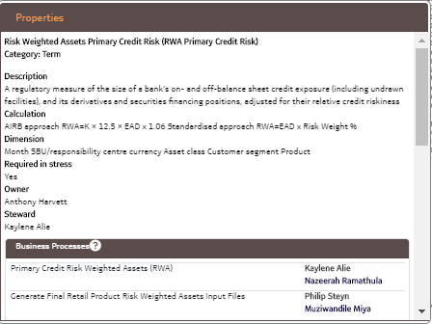
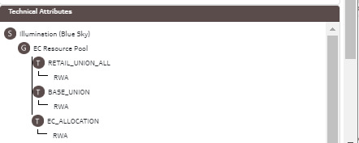
Description
A detailed definition of the term
Owner
The person who owns the term and is accountable for the definition and maintenance of the term (the data owner)
Steward
The steward of the term. The person responsible for the definition and maintenance of the term (the data steward)
Calculation
If the term is a calculated value, the calculation logic can be seen here
Dimension
If the term is reported on, the dimensions for reporting can be seen here
Required in Stress
Indicates whether the term is needed for reporting in times of stress.
Business Processes
Business processes linked to the term (i.e. processes that either create or utilise the term that have been identified)
Technical Attributes
Indicates the physical location(s) of the where the term is located in the system landscape
Term Properties:

Slide 26
Business Processes
2.3

Slide 27
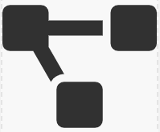
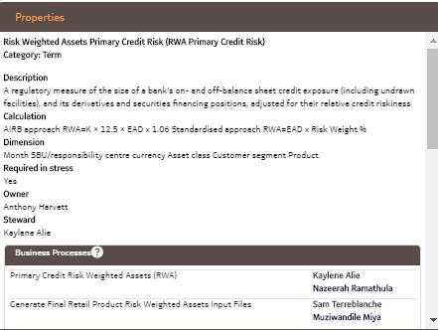
Taxonomy View
Lineage View
Taxonomy
Term
Term
Business Process
Taxonomy
Taxonomy
Term
Term
Terms can also be linked to Business Processes.
These should represent the processes that create or utilise the term.
A term can be linked to more than one business process
Linked processes can be viewed on a Term’s Properties.
Ideally these business processes should represent business processes that are documented in iServer.

Slide 29
View Details
2.4

Slide 30
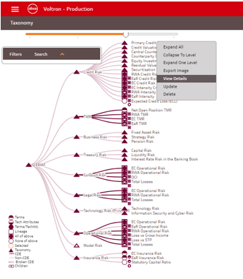

Right Click
If you would like to view the detailed information for a taxonomy/term, right click and then select View Details

Slide 31
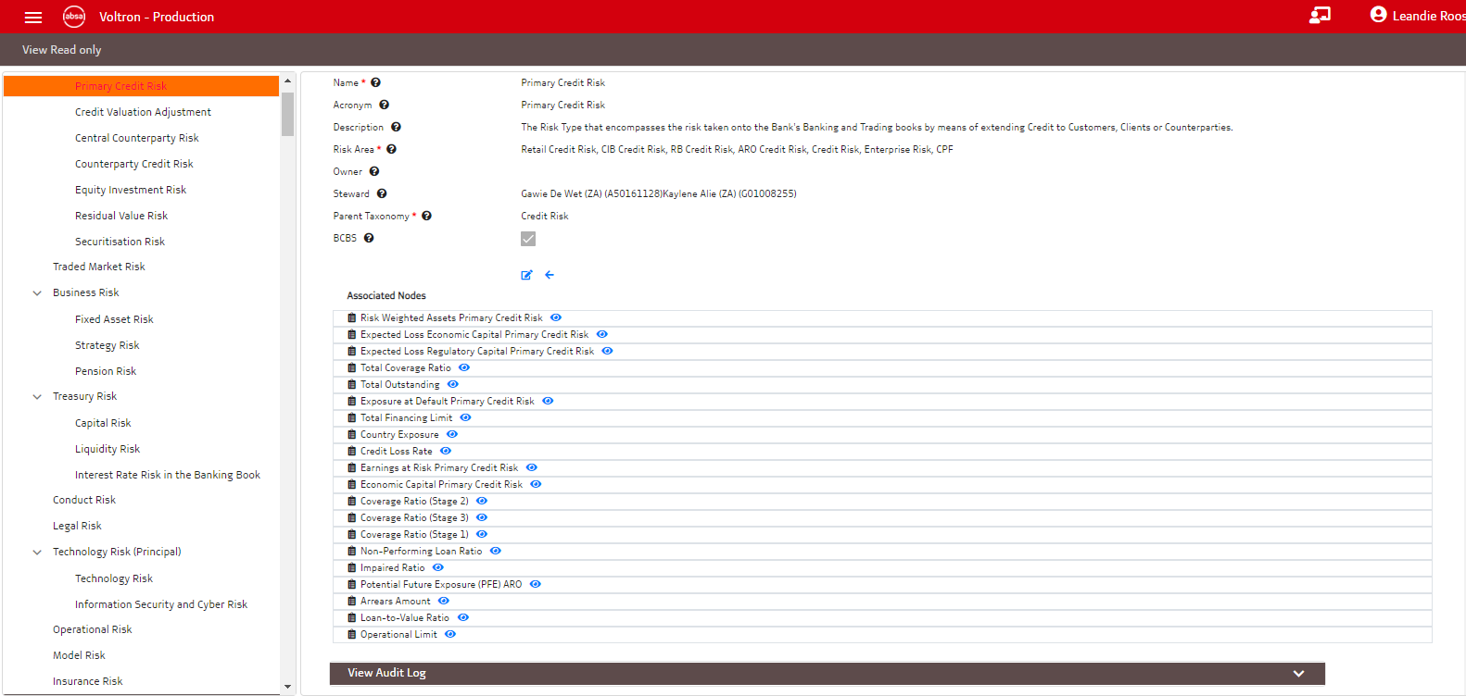
On this screen you are able to see all the info available for the selected item.
Tooltips are available next to each of the fields if you need more info.
You are also able to see everything the selected item is linked to on Voltron under Associated Nodes
At the bottom of the screen you are also able to view the audit log showing all past changes made to the selected item

Slide 32
Navigation Features
2.5

Slide 33
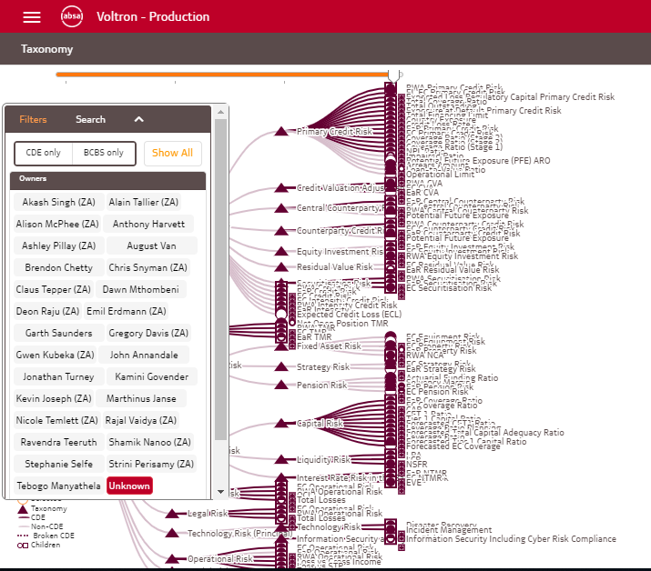
Filters
There are two filters available on the Filter Tab of the taxonomy view:
CDE only – by selecting this you will only see Critical Data Elements on the Taxonomy View
BCBS only – by selecting this you will only see BCBS relevant information on the Taxonomy View
You are able to select the two filters individually or together by clicking on the names

Slide 34
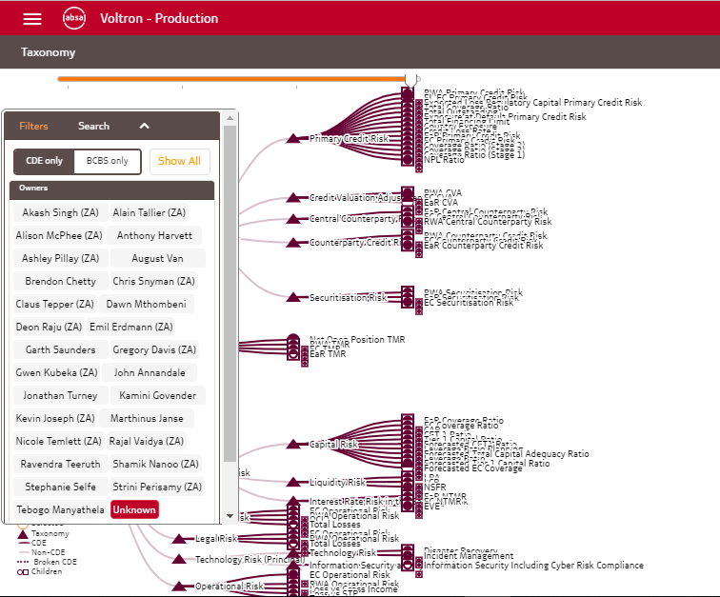
Filters
On this screenshot, the CDE only filter is selected, so all non-CDEs are no longer being displayed.

Slide 35
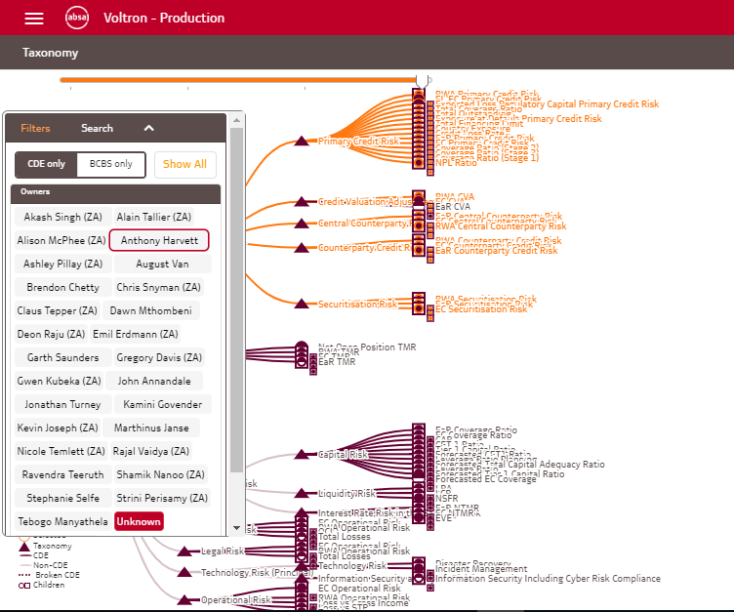
Filters
You are also able to filter on a specific Owner/Steward to see the items relevant to them.
In this example Anthony Harvett is selected and the items he owns have been highlighted in orange

Slide 36
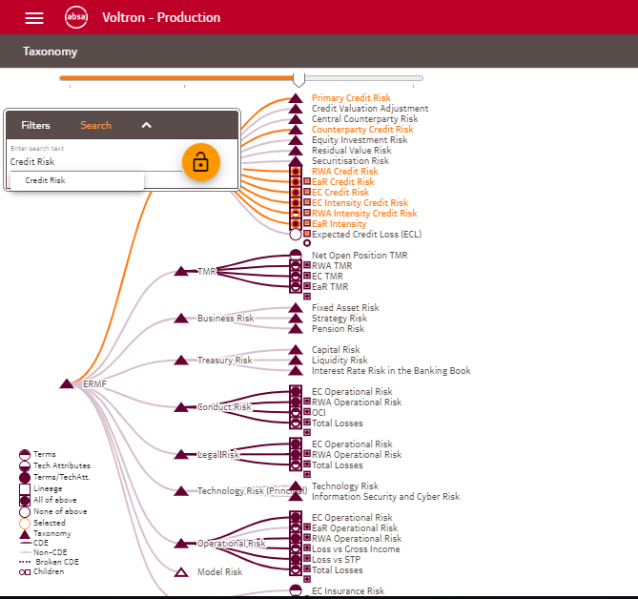
On-screen Search
The taxonomy view has a on-screen search functionality allowing you to search and highlight items on the screen
In this example a search was done for the words ‘Credit Risk’ and all the matching items have been highlighted in orange.
Important Note:
This search functionality only searches for the content available on the screen. To search the whole of Voltron the Search functionality located in the main menu (top left menu) must be used.

Slide 37

Slider
At the top of the taxonomy view, you can find a slider, which allows you to collapse/expand levels of detail by sliding the marker left and right

Slide 38
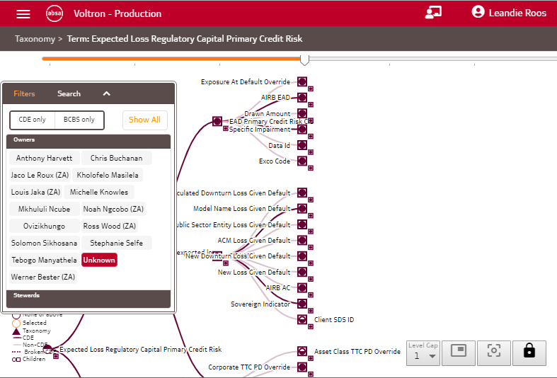
Level Gap
The first button on the bottom right of your screen allows you to increase the space between the displayed levels
This can ease readability where there are long term names not displaying optimally

Slide 39
Lock/Unlock Screen
The last button on the taxonomy screen allows you to unlock the content on the screen in order to scroll through the diagram.
This is useful where there are large volumes of information being displayed.

Slide 40
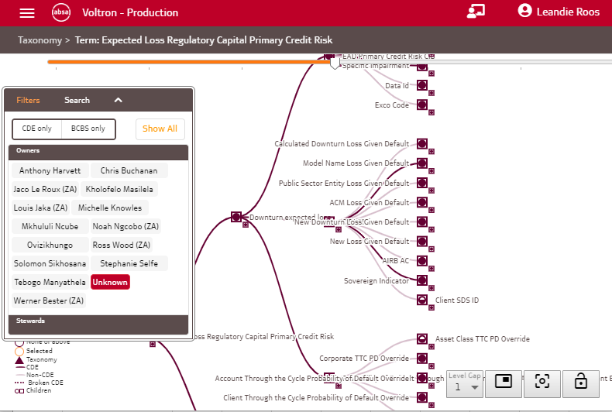
Re-center
Once your screen is unlocked you may want to move back to the center of the diagram.
To do so you can use the re-center button.

Slide 41
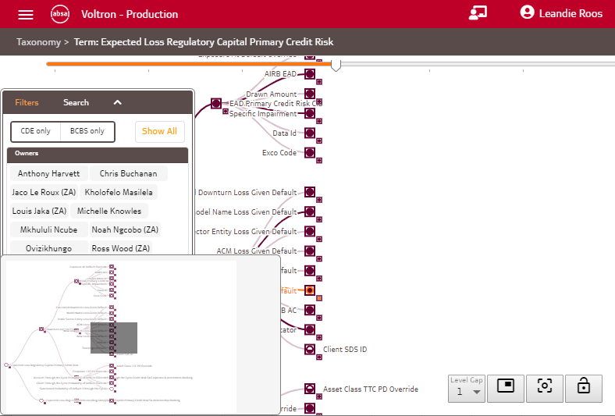
Mini-Map
Once your screen is unlocked you can also navigate to sections on the diagram using the mini-map functionality.
To access this click on the mini-map button.
The mini-map will then open and you can navigate to portions of the diagram by clicking on the mini-map.

Slide 42
Lineage View
3

Slide 43
Object Types
3.1

Slide 44
Taxonomy View
Lineage View
Taxonomy
Term
Term
Business Process
Taxonomy
Taxonomy
Term
Term
The lineage view represents the physical data flow of the data described in the taxonomy.
There are 4 types of objects represented on this view:

Slide 45
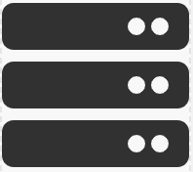
Taxonomy View
Lineage View
Taxonomy
Term
Term
Business Process
Taxonomy
Taxonomy
Term
Term
System
Generic Function
1. The systems which store, sends and receives data

Slide 46
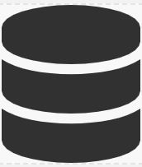
Taxonomy View
Lineage View
Taxonomy
Term
Term
Business Process
Taxonomy
Taxonomy
Term
Term
System
Generic Function
A system contains groups which can represent the physical databases or schemas within the system
Group

Slide 47
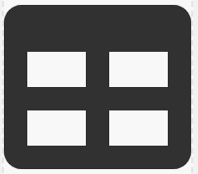
Taxonomy View
Lineage View
Taxonomy
Term
Term
Business Process
Taxonomy
Taxonomy
Term
Term
System
Generic Function
Groups contains the physical tables in which data is stored.
Group
TableFile

Slide 48

Taxonomy View
Lineage View
Taxonomy
Term
Term
Business Process
Taxonomy
Taxonomy
Term
Term
System
Generic Function
Group
Tables contain the physical attributes which is the field level information on where a term is stored
TableFile
Attribute

Slide 49
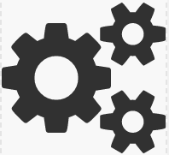
Taxonomy View
Lineage View
Taxonomy
Term
Term
Business Process
Taxonomy
Taxonomy
Term
Term
System
Generic Function
Group
TableFile
Attribute
2. The second type of object is called a Generic Function. These represent manual processes that uses and produces terms. These can be EUDAs or any other type of manual data transformation step

Slide 50
Taxonomy View
Lineage View
Taxonomy
Term
Term
Business Process
Taxonomy
Taxonomy
Term
Term
System
Generic Function
A generic function also contains groups. In this context a group can be a data file name or another logical grouping of data produced or used within the generic function.
Group
Group
TableFile
Attribute

Slide 51
Taxonomy View
Lineage View
Taxonomy
Term
Term
Business Process
Taxonomy
Taxonomy
Term
Term
System
Generic Function
A group also contains a TableFile which might be a file name or a tab within an excel workbook.
Group
Group
TableFile
TableFile
Attribute

Slide 52
Taxonomy View
Lineage View
Taxonomy
Term
Term
Business Process
Taxonomy
Taxonomy
Term
Term
System
Generic Function
The TableFile contains attributes which is the field level names of the data produced or used within the Generic Function.
Group
Group
TableFile
TableFile
Attribute
Attribute

Slide 53

Taxonomy View
Lineage View
Taxonomy
Term
Term
Business Process
Taxonomy
Taxonomy
Term
Term
System
Generic Function
Group
Group
Report
TableFile
TableFile
Attribute
Attribute
3. The third type of object found on the lineage view is a report. This represents reports that are produced as part of the data flow.

Slide 54
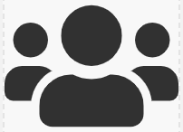
Taxonomy View
Lineage View
Taxonomy
Term
Term
Business Process
Taxonomy
Taxonomy
Term
Term
System
Generic Function
Group
Group
Report
Committee
TableFile
TableFile
Attribute
Attribute
4. The fourth and final type of object found on the lineage view is a committee. These are the committees within the bank which use the reports to make decisions.

Slide 55
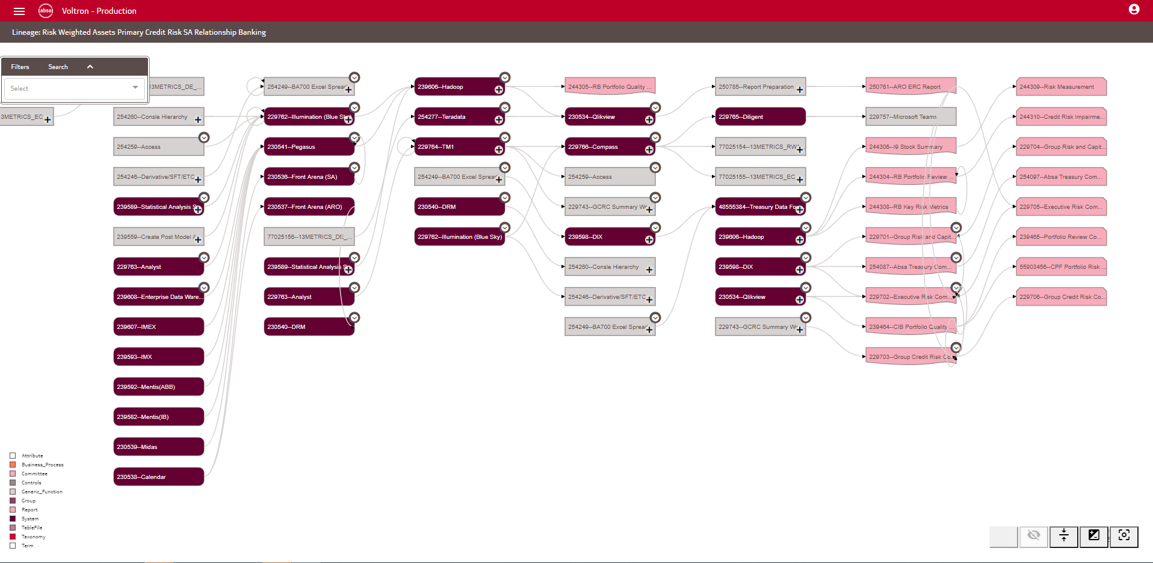
Voltron Lineage View Example
On the Voltron Lineage view, systems are represented by dark purple blocks.
Single Click
In order to view the underlying information, click on the + sign on the system.

Slide 56

Voltron Lineage View Example
This will then show all groups available on the system
Single Click
In order to view the underlying information, click on the + sign on the relevant group.

Slide 57
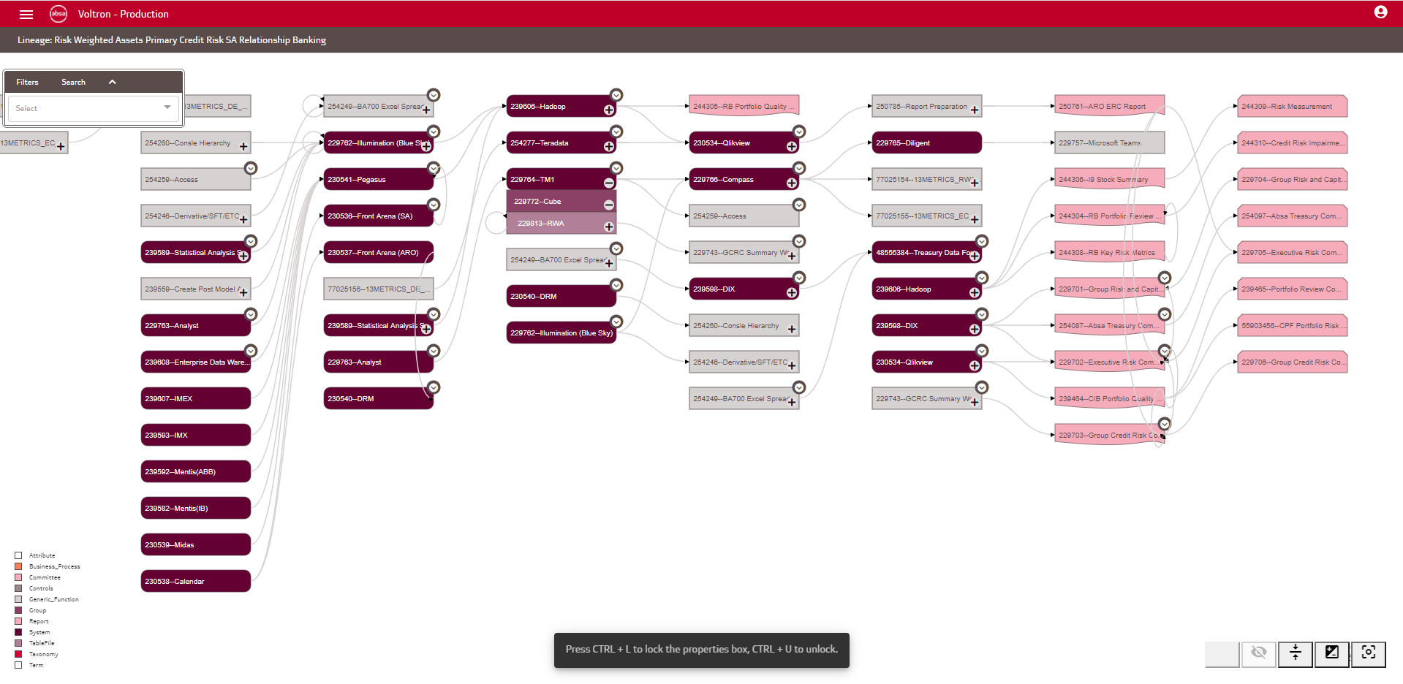
Voltron Lineage View Example
This will then show all tables available in the group
Single Click
In order to view the underlying information, click on the + sign on the relevant table.

Slide 58
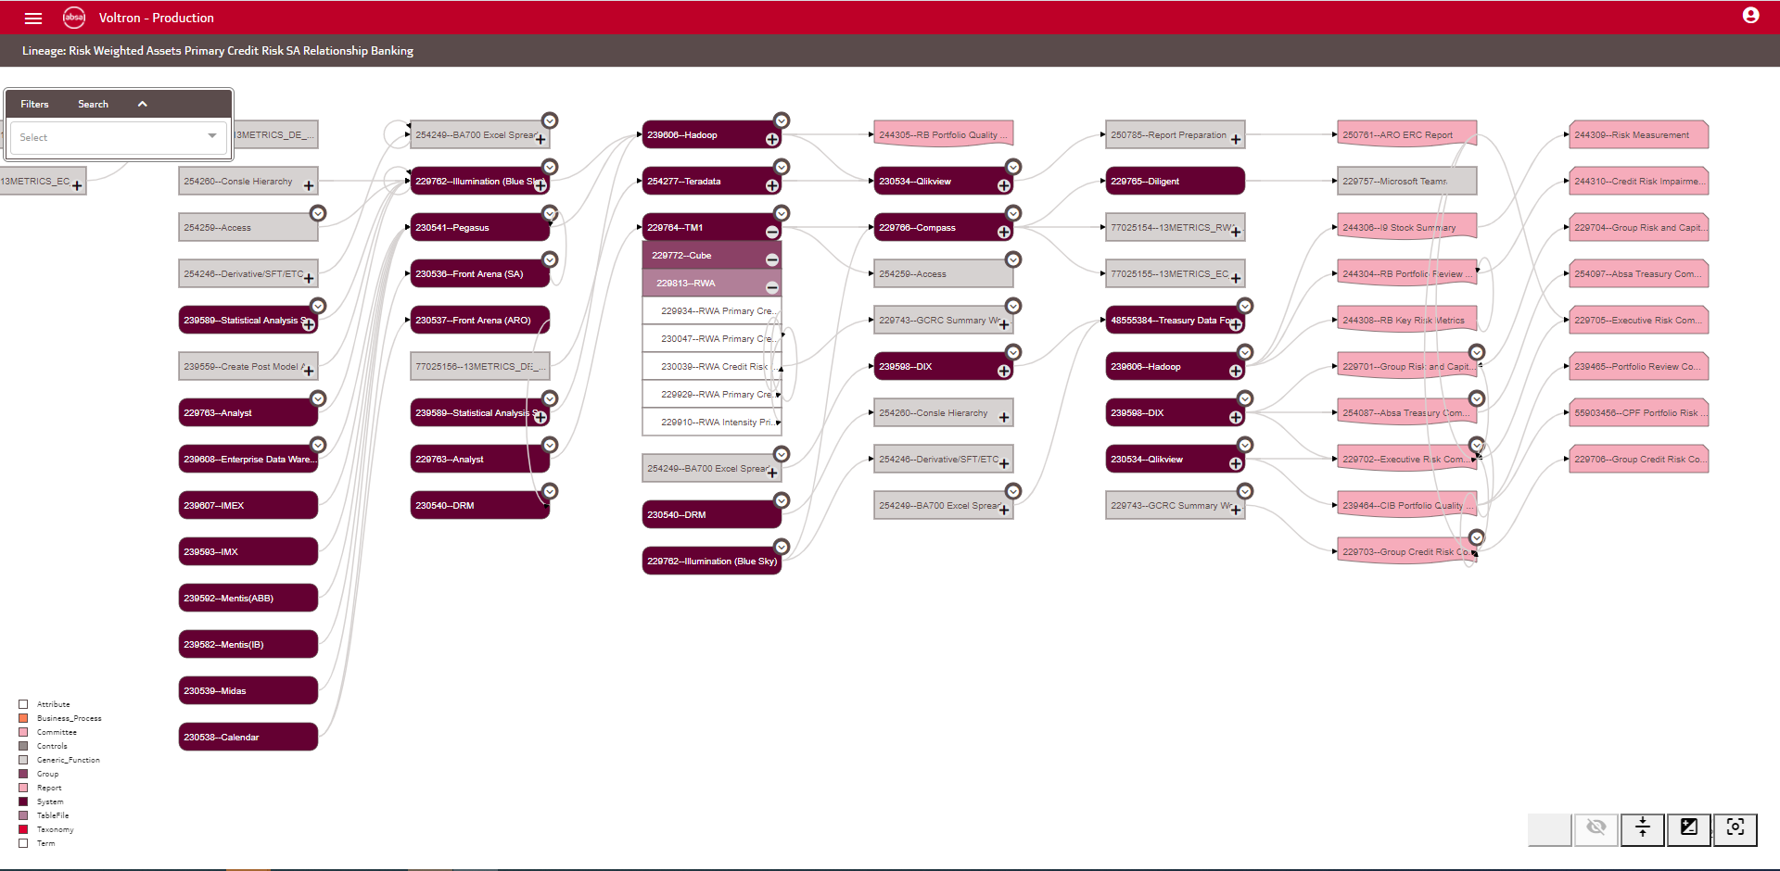
Voltron Lineage View Example
You can now view all the attributes in the table.

Slide 59
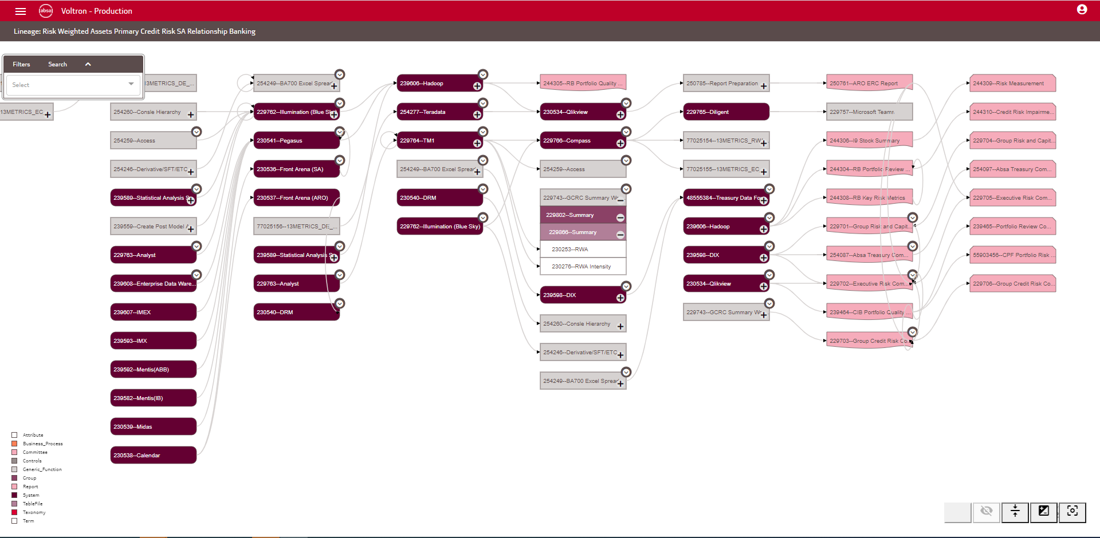
Voltron Lineage View Example
The same applies to the levels under a generic function.

Slide 60
Voltron Lineage View Example
Reports are indicated using this shape on the lineage
And committees are represented by this shape.

Slide 61
Data Flow
3.2

Slide 62
Taxonomy View
Lineage View
Taxonomy
Term
Term
Business Process
Taxonomy
Taxonomy
Term
Term
In the lineage view data can flow in the following ways:
System
Generic Function
Group
Group
Report
Committee
TableFile
TableFile
Attribute
Attribute
1. Between a System and a Generic Function

Slide 63
Taxonomy View
Lineage View
Taxonomy
Term
Term
Business Process
Taxonomy
Taxonomy
Term
Term
In the lineage view data can flow in the following ways:
System
Generic Function
2. Between a Generic Function and a System
Group
Group
Report
Committee
TableFile
TableFile
System
Attribute
Attribute
Group
TableFile
Attribute

Slide 64
Taxonomy View
Lineage View
Taxonomy
Term
Term
Business Process
Taxonomy
Taxonomy
Term
Term
In the lineage view data can flow in the following ways:
System
Generic Function
Group
Group
Report
Committee
TableFile
TableFile
System
Attribute
Attribute
Group
3. Between a System and a Report
TableFile
Attribute

Slide 65
Taxonomy View
Lineage View
Taxonomy
Term
Term
Business Process
Taxonomy
Taxonomy
Term
Term
In the lineage view data can flow in the following ways:
4. Between a Generic Function and a Report
System
Generic Function
Group
Group
Report
Committee
TableFile
TableFile
System
Attribute
Attribute
Group
TableFile
Attribute

Slide 66
Taxonomy View
Lineage View
Taxonomy
Term
Term
Business Process
Taxonomy
Taxonomy
Term
Term
In the lineage view data can flow in the following ways:
System
Generic Function
Group
Group
Report
Committee
TableFile
TableFile
5. Between a Report and a System.
System
Attribute
Attribute
Group
TableFile
Report
Attribute

Slide 67
Taxonomy View
Lineage View
Taxonomy
Term
Term
Business Process
Taxonomy
Taxonomy
Term
Term
In the lineage view data can flow in the following ways:
System
Generic Function
Group
Group
Report
Committee
TableFile
TableFile
System
Attribute
Attribute
Group
6. Between a Report and a Generic Function
TableFile
Report
Attribute

Slide 68
Taxonomy View
Lineage View
Taxonomy
Term
Term
Business Process
Taxonomy
Taxonomy
Term
Term
In the lineage view data can flow in the following ways:
System
Generic Function
Group
Group
Report
Committee
TableFile
TableFile
System
Attribute
Attribute
Group
6. Between a Report and a Committee
TableFile
Report
Attribute

Slide 69
Taxonomy View
Lineage View
Taxonomy
Term
Term
Business Process
Taxonomy
Taxonomy
Term
Term
Once all of these links are created it provides a end-to-end view of how data flows
System
Generic Function
Group
Group
Report
Committee
TableFile
TableFile
System
Attribute
Attribute
Group
TableFile
Report
Attribute

Slide 70
Linkages between the Taxonomy View and the Lineage View
3.3

Slide 71
Taxonomy View
Lineage View
Taxonomy
Term
Term
Business Process
Taxonomy
Taxonomy
Term
Term
The next few slides will show how the Taxonomy View information links to the lineage view
System
Generic Function
Group
Group
Report
Committee
TableFile
TableFile
System
Attribute
Attribute
Group
TableFile
Report
Attribute

Slide 72
Taxonomy View
Lineage View
Taxonomy
Term
Term
Business Process
Taxonomy
Taxonomy
Term
Term
Where a term is created or used within a system, a relationship can be created by linking the system to the term. This can be done at an attribute, TableFile, Group or System level.
It is recommended to create this link at an attribute level as this will increase the accuracy of the lineage information available.
System
Generic Function
Group
Group
Report
Committee
TableFile
TableFile
System
Attribute
Attribute
Group
TableFile
Report
Attribute

Slide 73
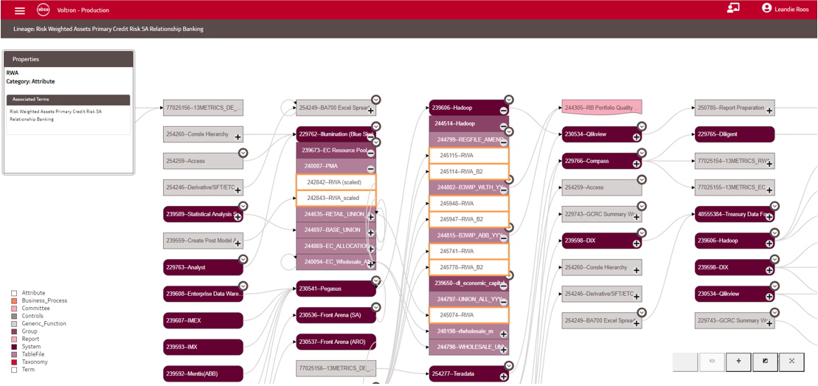
To view a linked terms on the lineage view, hover on the relevant attribute and then the associated terms will be displayed on the properties.
Hover

Slide 74
Taxonomy View
Lineage View
Taxonomy
Term
Term
Business Process
Taxonomy
Taxonomy
Term
Term
Where a term is created or used within a generic function (or manual process), a relationship can be created by linking the Generic Function to the term. This can be done at an attribute, TableFile, Group or Generic Function level.
It is recommended to create this link at an attribute level as this will increase the accuracy of the lineage information available.
System
Generic Function
Group
Group
Report
Committee
TableFile
TableFile
System
Attribute
Attribute
Group
TableFile
Report
Attribute

Slide 75
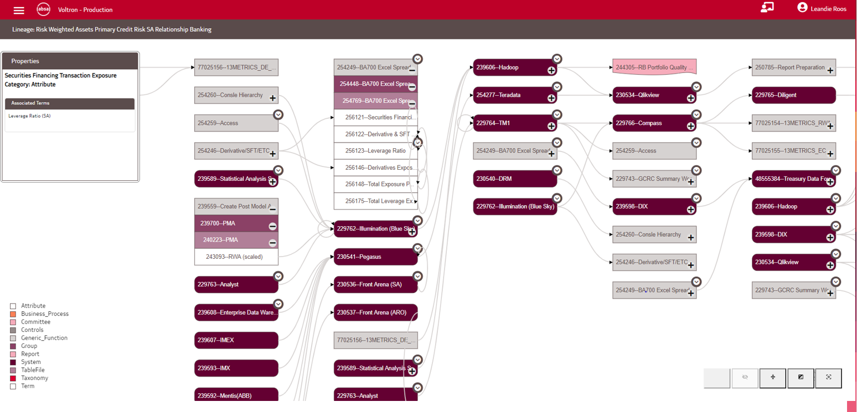
Hover
To view linked terms on the lineage view, hover on the relevant attribute under a Generic Function and then the associated terms will be displayed on the properties.

Slide 76
Taxonomy View
Lineage View
Taxonomy
Term
Term
Business Process
Taxonomy
Taxonomy
Term
Term
Where a term is used within a report, a relationship can be created by linking the Report to the term.
System
Generic Function
Group
Group
Report
Committee
TableFile
TableFile
System
Attribute
Attribute
Group
TableFile
Report
Attribute

Slide 77
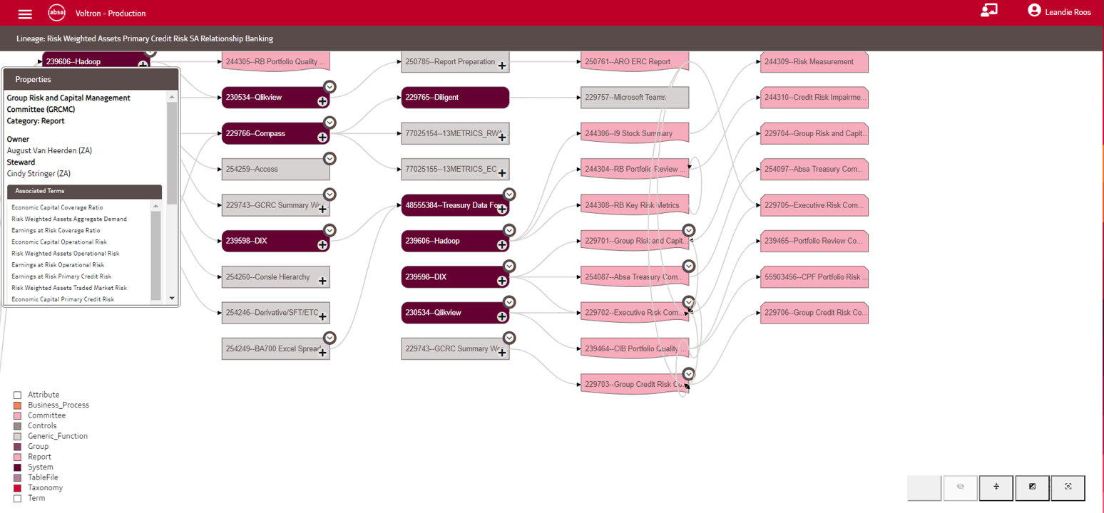
Hover
To view linked terms on the lineage view, hover on the relevant Report and then the associated terms will be displayed on the properties.

Slide 78
Controls
3.4

Slide 79

Taxonomy View
Lineage View
Taxonomy
Term
Term
Business Process
Taxonomy
Taxonomy
Term
Term
Control
Controls on Voltron refers to controls applied to data to ensure integrity and data quality.
System
Generic Function
Group
Group
Report
Committee
TableFile
TableFile
System
Attribute
Attribute
Group
TableFile
Report
Attribute

Slide 80
Taxonomy View
Lineage View
Taxonomy
Term
Term
Business Process
Taxonomy
Taxonomy
Where a control is executed for/by a system, a control can be linked to the relevant system. Examples of this include Record Counts, Reconciliations and Operational Level Agreements.
Term
Term
Control
System
Generic Function
Group
Group
Report
Committee
TableFile
TableFile
System
Attribute
Attribute
Group
TableFile
Report
Attribute

Slide 81
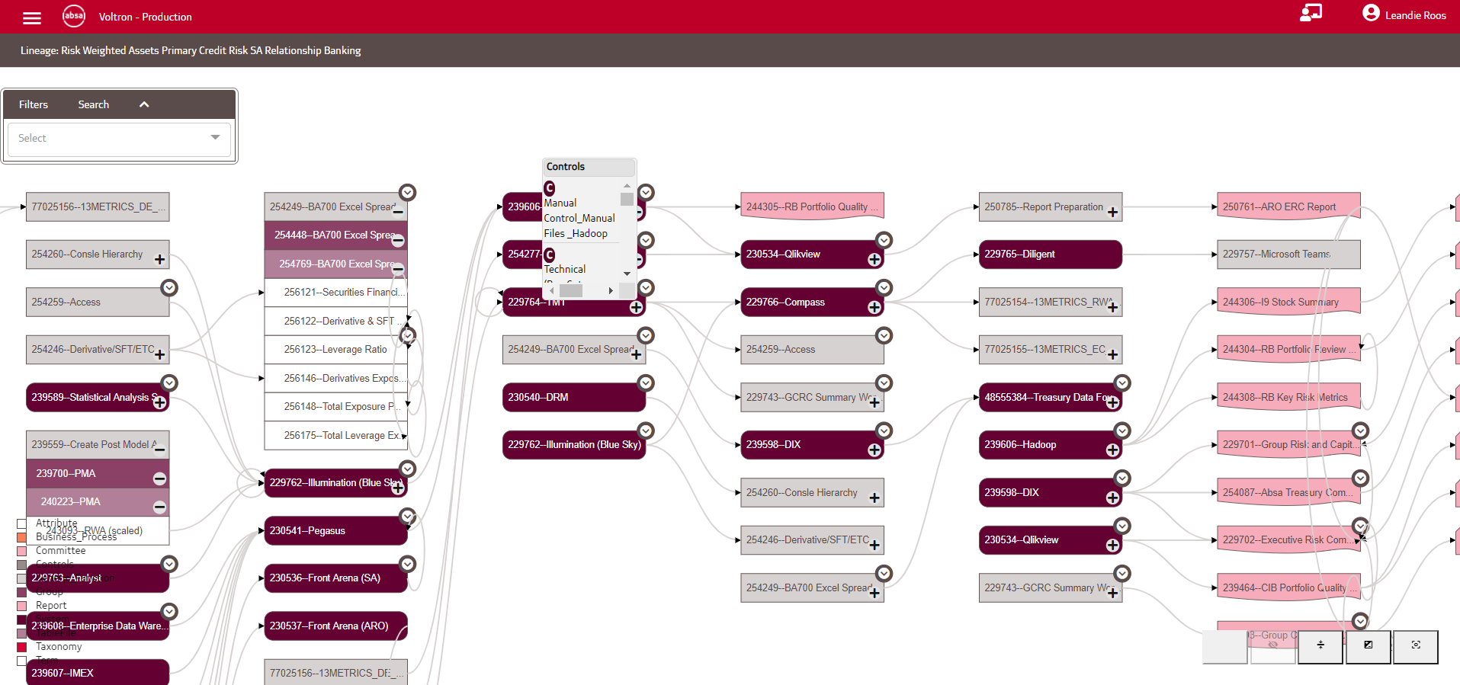
To view the controls linked to a system, click on the dropdown arrow on the top left of the relevant system
Single Click

Slide 82

Hover
You are then able to hover over the applicable control to view it’s properties.

Slide 83
Taxonomy View
Lineage View
Taxonomy
Term
Term
Business Process
Taxonomy
Taxonomy
If controls are applied as part of a Generic Function, a control can be linked to the relevant Generic Function. Examples of this include Reconciliations, Attestations and Data Quality checks.
Term
Term
Control
System
Generic Function
Group
Group
Report
Committee
TableFile
TableFile
System
Attribute
Attribute
Group
TableFile
Report
Attribute

Slide 84
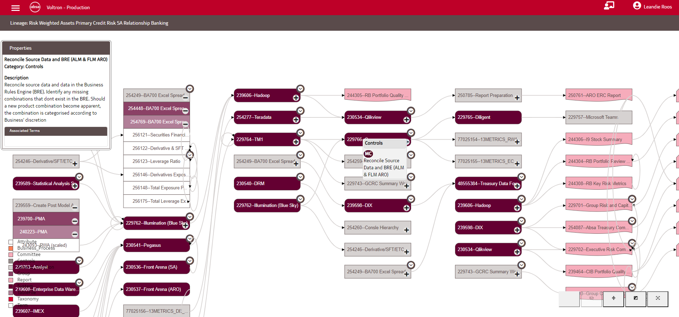
To view the controls linked to a Generic Function, click on the dropdown arrow on the top left of the relevant Generic Function.
Single Click

Slide 85
Hover
You are then able to hover over the applicable control to view it’s properties.

Slide 86
Taxonomy View
Lineage View
Taxonomy
Term
Term
Business Process
Taxonomy
Taxonomy
Term
Where a control is executed as part of the process of producing a Report, a control can be linked to the relevant Report. Examples of this include Attestations and Operational Level Agreements.
Term
Control
System
Generic Function
Group
Group
Report
Committee
TableFile
TableFile
System
Attribute
Attribute
Group
TableFile
Report
Attribute

Slide 87
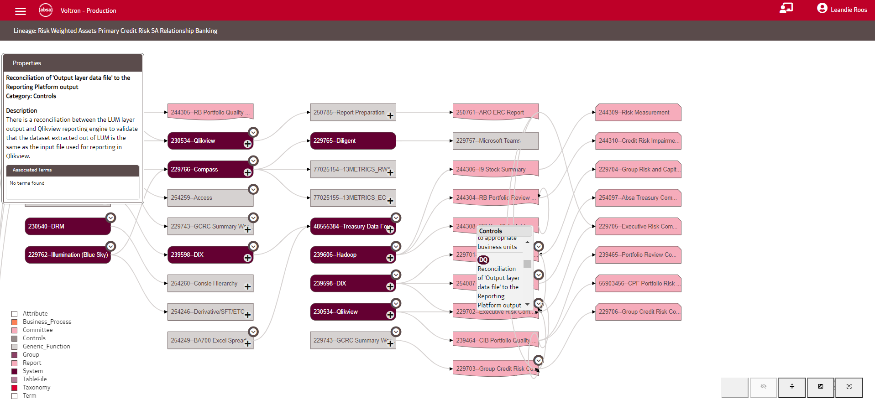
To view the controls linked to a Report, click on the dropdown arrow on the top left of the relevant Report.
Single Click

Slide 88
You are then able to hover over the applicable control to view it’s properties.
Hover

Slide 89
Taxonomy View
Lineage View
All object types and relationships have now been covered
Taxonomy
Term
Term
Business Process
Taxonomy
Taxonomy
Term
Term
Control
System
Generic Function
Group
Group
Report
Committee
TableFile
TableFile
System
Attribute
Attribute
Group
TableFile
Report
Attribute

Slide 90
Taxonomy View
Lineage View
Taxonomy
Term
Term
Business Process
Taxonomy
Taxonomy
Term
Term
Control
System
Generic Function
Group
Group
Report
Committee
TableFile
TableFile
System
Attribute
Attribute
Group
TableFile
Report
Attribute

Slide 91
Template Completion Guide
4

Slide 92
Completing the Template
When doing bulk uploads onto Voltron, you are able to use an excel template. This can be used to add new information, but not to update existing information.
This section of the training will take you through the template tab by tab.
There are two types of tabs in the template:
  Object tabs: Creates objects as used within Voltron e.g. taxonomies, terms, reports etc.
  Relationship tabs: Contains information that is used to build relationships between objects like term to term mappings, and report to term mappings.

Slide 93
Template Admin
The first three tabs contain admin information about the different tabs:
HistoryDetails: Contains the version control information for the template.
Table Lookup: Contains the set dropdown values used throughout the template.
Template Information: Contains metadata about the template.

Slide 94
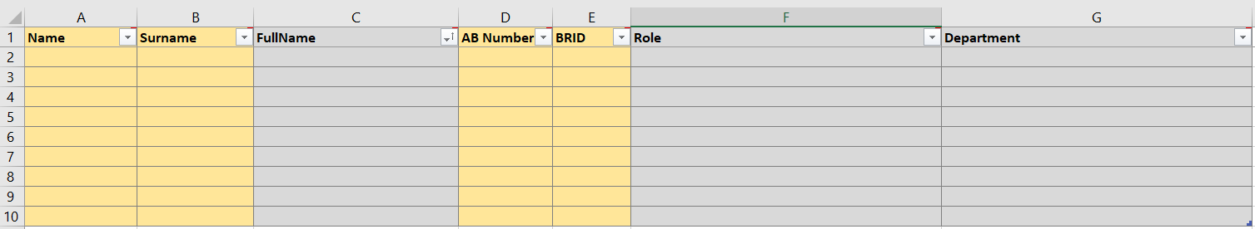
Person
On the Person Tab all owners/stewards that are used throughout the template need to be captured.
The most critical fields on the tab is: Name and Surname (which automatically complete the FullName field) and the BRID number.

Slide 95
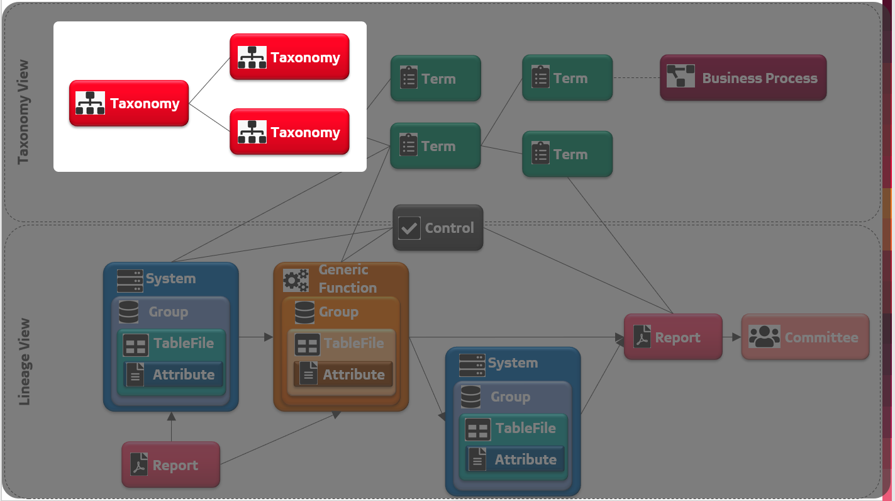
Taxonomy Tab: About
The taxonomy tab should contain all data domains that will be used to build up your taxonomy
This creates the red blocks on the diagram that will be used to create your taxonomy structure.

Slide 96
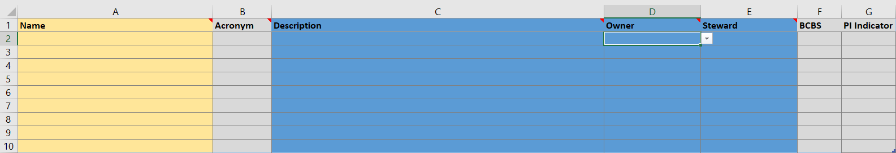
Taxonomy Tab – Fields
Name: the unique name for the taxonomy. This should be business language.
Description: The business definition for the taxonomy.
Acronym: If applicable, capture the acronym for the taxonomy. Note: This is what will be displayed on the taxonomy view on Voltron
Owner + Steward: Indicates the owner and steward for the taxonomy. This will be populated from the records captured on the Person Tab.
BCBS: This is a true/false indicator to indicate whether the taxonomy is in scope for BCBS239 compliance as per the RDARR Policy. If not relevant, leave blank.
PI Indicator: This is a true/false indicator to indicate whether the taxonomy contains Personal Information in terms of the Privacy Policy. If not relevant, leave blank.

Slide 97
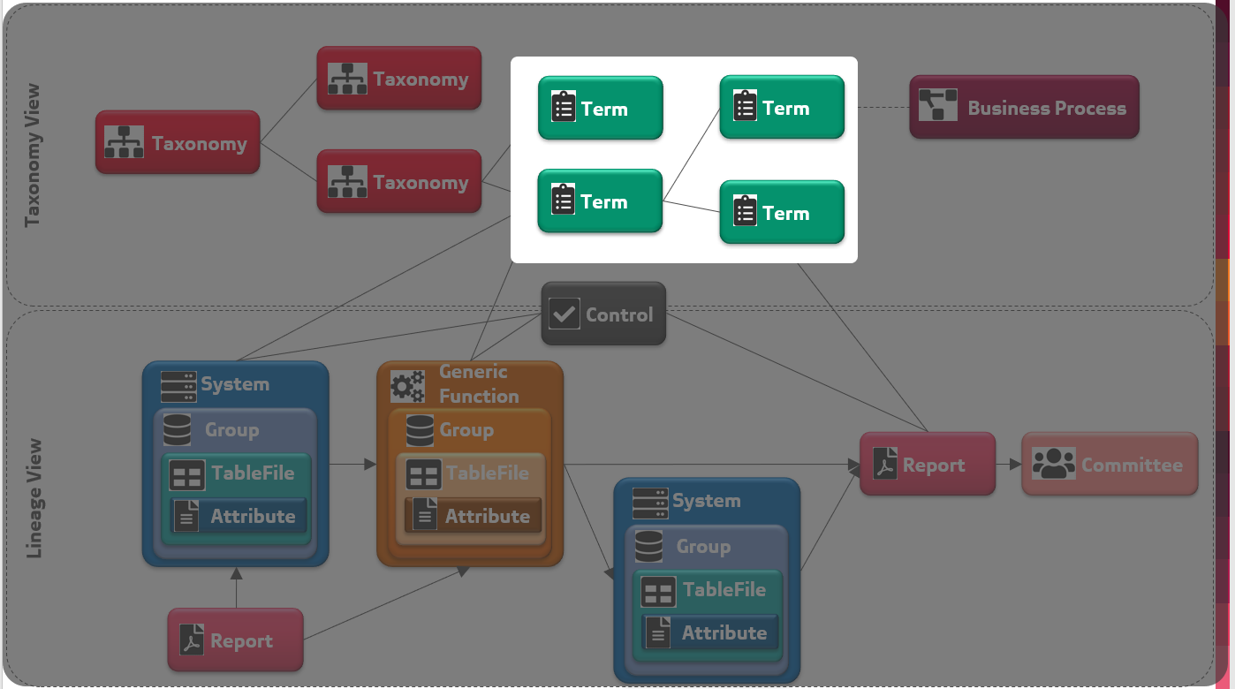
Term Tab: About
The term tab should contain all business data elements that will be linked to your taxonomies.
This creates the green blocks on the diagram that will linked into your taxonomies and to other terms.

Slide 98
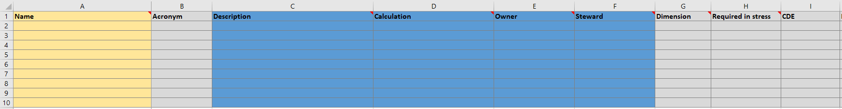
Term Tab – Fields (1 of 2)
Name: the unique name for the term. This should be business language.
Description: The business definition for the term.
Dimension: If the term is used for reporting, the dimensions used to aggregate/segment the term can be captured here. If not relevant, leave blank.
Calculation: If the term is a calculated value, the calculation or rules for calculation can be captured here. If not relevant, leave blank.
CDE: Indicates whether the term is a critical data element or not.
Acronym: If applicable, capture the acronym for the term. Note: This is what will be displayed on the taxonomy view on Voltron
Owner + Steward: Indicates the owner and steward for the term. This will be populated from the records captured on the Person Tab.
Required in stress: If the term is used for reporting in times of stress/crisis, this should be set as true. If not relevant, leave blank.

Slide 99
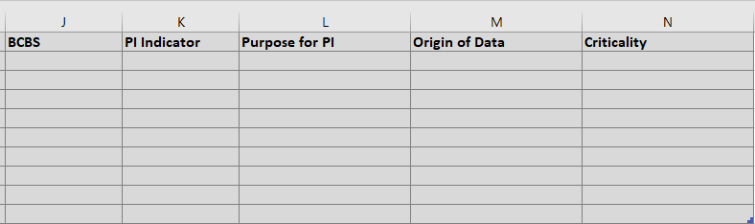
Term Tab – Fields (2 of 2)
BCBS: This is a true/false indicator to indicate whether the term is in scope for BCBS239 compliance as per the RDARR Policy. If not relevant, leave blank.
PI Indicator: This is a true/false indicator to indicate whether the term is in scope as Personal Information in terms of the Privacy Policy. If not relevant, leave blank.
Purpose for PI: Indicates for what purpose the term had been obtained for in terms of the Privacy Policy. Based on a set drop-down list. Only relevant for PI.
Origin of data: Indicates for where the data originated at the point of entering the bank. Mandatory for PI.
Origin of data: Indicates the criticality of the field for business.

Slide 100
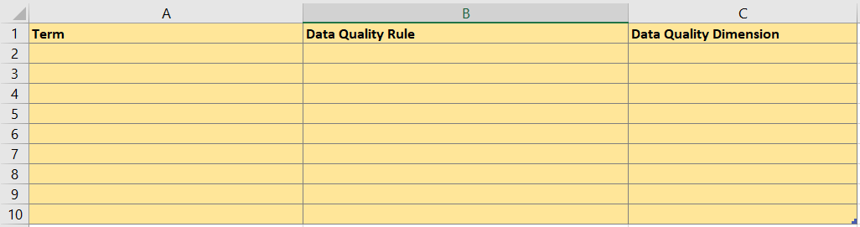
Data Quality Rules Tab: About and Fields
As one term can have many data quality rules associated, these DQ rules are captured on the Data Quality Rules tab:
Note: One term can have many rules. So repeat the term in column A as many times as needed.
Term: Select the term that the DQ rule applies to from the dropdown. This dropdown is based on the terms populated on the term tab.
Data Quality Rule: Capture the rule that will be used to measure DQ for the specific term.
Data Quality Dimension: Capture the data quality dimension that will be measured using the defined rule.

Slide 101
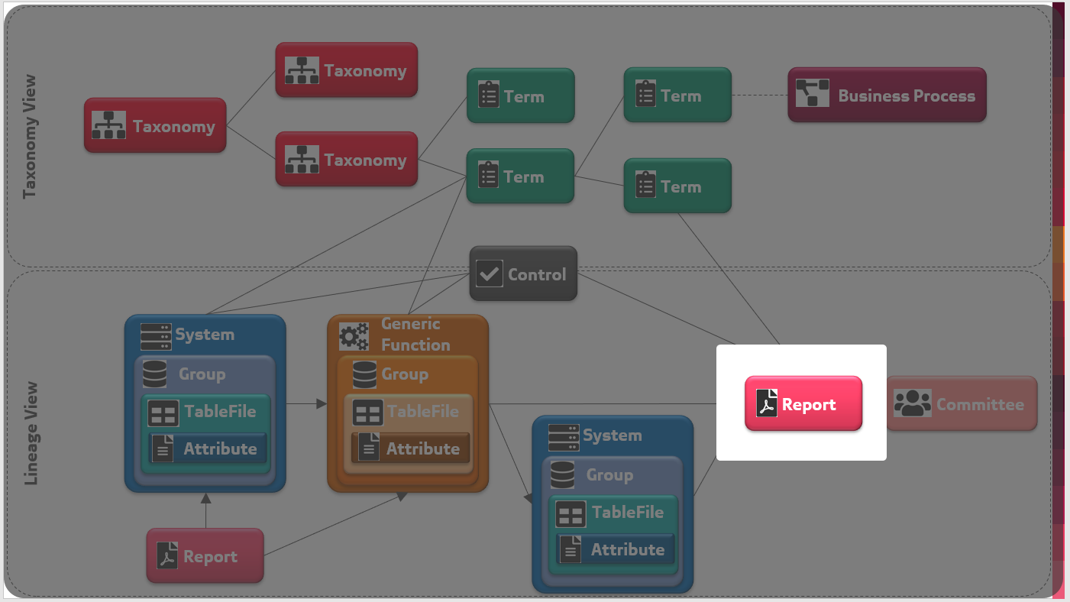
Report Tab: About
The report tab should contain all report in scope for the set of metadata you are capturing.
This creates the pink blocks that will be linked to terms and controls and will also form part of the lineage view

Slide 102
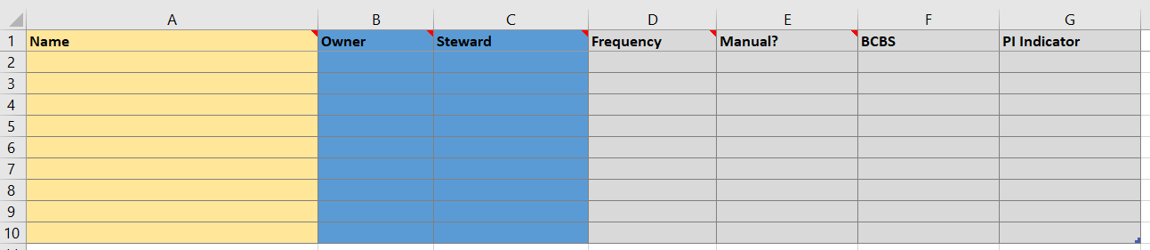
Report Tab – Fields
Name: the unique name for the report. This should be business language.
Owner + Steward: Indicates the owner and steward for the report. This will be populated from the records captured on the Person Tab.
Manual: Indicates whether the report is produced manually or not.
Frequency: Indicates how frequently the report is produced
BCBS: This is a true/false indicator to indicate whether the report is in scope for BCBS239 compliance as per the RDARR Policy. If not relevant, leave blank.
PI Indicator: This is a true/false indicator to indicate whether the report contains Personal Information in terms of the Privacy Policy. If not relevant, leave blank.

Slide 103
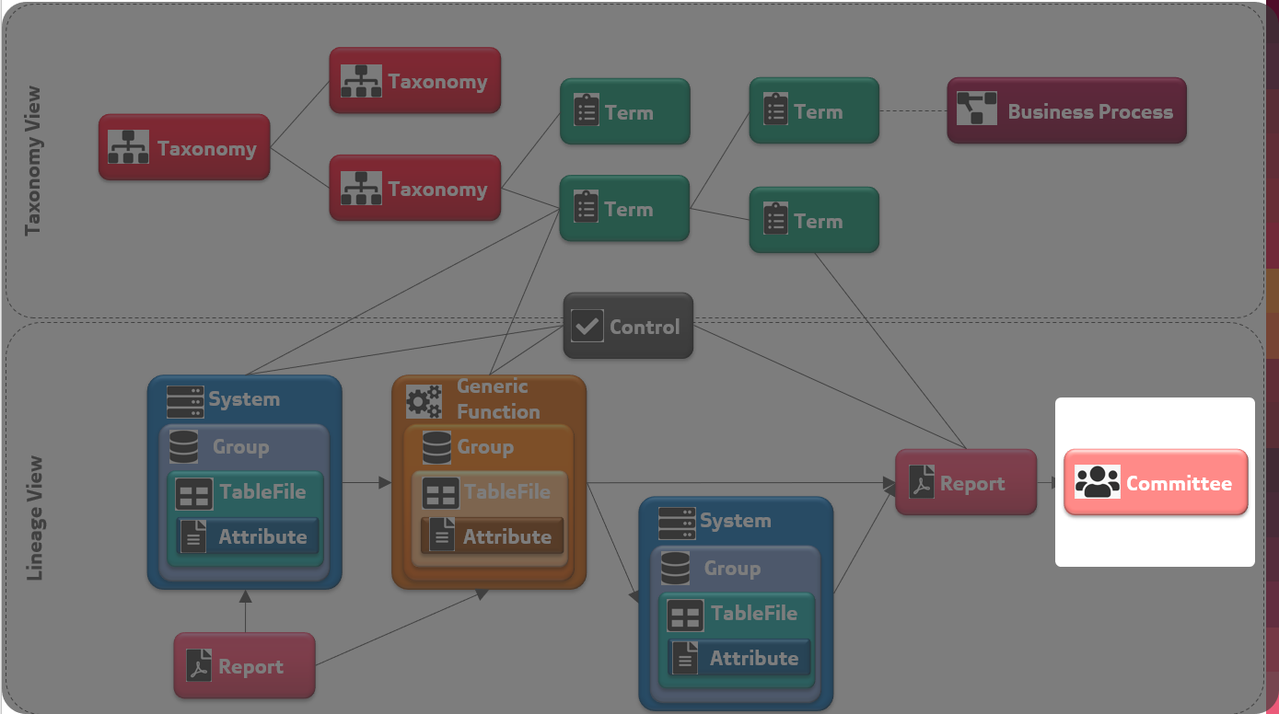
Committee Tab: About
The committee tab should contain all committees in scope for the set of metadata you are capturing.
This creates the light pink blocks on the diagram and will link to reports on the lineage view.

Slide 104

Committee Tab – Fields
Name: the unique name for the committee. This should be business language.
Acronym: If applicable, capture the acronym for the committee. Note: This is what will be displayed on the lineage view on Voltron
Owner + Steward: Indicates the owner and steward for the committee. This will be populated from the records captured on the Person Tab.
Frequency: Indicates how frequently the committee convenes.
BCBS: This is a true/false indicator to indicate whether the committee is in scope for BCBS239 compliance as per the RDARR Policy. If not relevant, leave blank.
PI Indicator: This is a true/false indicator to indicate whether the committee consumes Personal Information in terms of the Privacy Policy. If not relevant, leave blank.

Slide 105

Controls Tab: About
The controls tab should contain all controls executed as part of the data flow on the lineage view.
This creates the grey blocks on the diagram and will link to systems, generic functions and reports on the lineage view.

Slide 106

Controls Tab – Fields
Description: The business definition for the control.
Name: the unique name for the report. This should be business language.
Owner + Steward: Indicates the owner and steward for the control. This will be populated from the records captured on the Person Tab.
BCBS: This is a true/false indicator to indicate whether the control is in scope for BCBS239 compliance as per the RDARR Policy. If not relevant, leave blank.
PI Indicator: This is a true/false indicator to indicate whether the control relates to Personal Information in terms of the Privacy Policy. If not relevant, leave blank.
Acronym: The type of report as per a defined dropdown
Frequency: Indicates how frequently the control is executed.
Links: If evidence for a control is contained on a shared site/drive, the link can be inserted here.
Manual: Indicates whether a control is manual or not.

Slide 107
Document Tab: About
The document tab should contain all documents used/produced as part of the data flow on the lineage view.
Note: This is a new requirement being implemented on Voltron as part of the POPI requirements received. Updates to the material reflecting this will be made in Q1 2020. In the meantime the tab has been made available on the template to facilitate information gathering as part of the analysis being done.

Slide 108

Document Tab – Fields
Name: the unique name for the document.
Document Type: Indicates the type of the document.
NOTE: A reference list will be built up as more information is being captured into Voltron. Please provide required values to the Voltron team for vetting as part of your analysis.
BCBS: This is a true/false indicator to indicate whether the document is in scope for BCBS239 compliance as per the RDARR Policy. If not relevant, leave blank.
PI Indicator: This is a true/false indicator to indicate whether the document contains Personal Information in terms of the Privacy Policy. If not relevant, leave blank.

Slide 109

Generic Function Tab: About
The Generic Function tab should contain all manual steps/process that consume or produce data that form part of the data lineage.
Note: This creates the orange blocks on the diagram that will link into the lineage flow.

Slide 110

Generic Function Tab – Fields
Name: the unique name for the Generic Function
Description: The business definition for the Generic Function.
Manual: Indicates whether the generic function is executed manually or not.
BCBS: This is a true/false indicator to indicate whether the document is in scope for BCBS239 compliance as per the RDARR Policy. If not relevant, leave blank.
PI Indicator: This is a true/false indicator to indicate whether the document contains Personal Information in terms of the Privacy Policy. If not relevant, leave blank.
Owner + Steward: Indicates the owner and steward for the generic function. This will be populated from the records captured on the Person Tab.

Slide 111

GenFunc.Group Tab: About
The GenFunc.Group tab should contain all sub-processes/groupings within the Generic Function that are required to understand the lower level of detail of how the Generic Function Operates.
Note: This creates groups underlying the Generic Functions in the lineage view

Slide 112

GenFunc.Group Tab – Fields
System.Group: Automatically populated from columns A+B.
GenericFunction: The generic function that the group relates to. Populated using the generic functions capture don the Generic Function Tab
Name: the unique name for the Generic Function Group.
Acronym: If the group is known by an acronym, capture that here.
BCBS: This is a true/false indicator to indicate whether the Generic Function Group is in scope for BCBS239 compliance as per the RDARR Policy. If not relevant, leave blank.
PI Indicator: This is a true/false indicator to indicate whether the Generic Function Group uses/produces Personal Information in terms of the Privacy Policy. If not relevant, leave blank.
Owner + Steward: Indicates the owner and steward for the generic function group. This will be populated from the records captured on the Person Tab.
Alias: If the group is known by an alias, capture that here.

Slide 113

GenFunc.Table Tab: About
The GenFunc.Table tab should contain all files/tables/reports of data that is produced within the Generic Function that are required to understand the lower level of detail of how the Generic Function Operates.
Note: This creates tables/files underlying the groups for the Generic Functions in the lineage view

Slide 114

GenFunc.Table Tab – Fields
System.Group.Table: Automatically populated from columns A+B.
Name: the unique name for the Table or File
Group: The Generic Function Group that the table relates to. Populated using the Generic Function Group names from column G on the GenFun.Group Tab.
BCBS: This is a true/false indicator to indicate whether the Generic Function Table is in scope for BCBS239 compliance as per the RDARR Policy. If not relevant, leave blank.
PI Indicator: This is a true/false indicator to indicate whether the Generic Function Table uses/produces Personal Information in terms of the Privacy Policy. If not relevant, leave blank.
Owner + Steward: Indicates the owner and steward for the generic function table/file. This will be populated from the records captured on the Person Tab.

Slide 115

GenFunc.Attribute Tab: About
The GenFunc.Attribute tab should contain all fields/attributes of data that is produced within the Generic Function that are required to understand the lower level of detail of how the Generic Function Operates.
Note: This creates attributes/fields underlying the tables for the Generic Functions in the lineage view

Slide 116

GenFunc.Attribute – Fields
Name: the unique name for the Attribute.
System.Group.Table.Attribute: Automatically populated from columns A+C.
BCBS: This is a true/false indicator to indicate whether the Generic Function Attribute is in scope for BCBS239 compliance as per the RDARR Policy. If not relevant, leave blank.
PI Indicator: This is a true/false indicator to indicate whether the Generic Function Attribute is Personal Information in terms of the Privacy Policy. If not relevant, leave blank.
Table: The Generic Function Table/File that the attribute relates to. Populated using the Generic Function Table names from column C on the GenFunc.Table Tab.
Mandatory Indicator: Indicates whether the attribute is mandatory / Optional / Conditionally Mandatory as part of the Generic Function.
Type: The data type of the attribute. E.g. string, date, numeric.
Owner + Steward: Indicates the owner and steward for the generic function attribute. This will be populated from the records captured on the Person Tab.

Slide 117

System Tab: About
The System tab should contain all systems that consume or produce data that form part of the data lineage.
Note: This creates the blue blocks on the diagram that will link into the lineage flow.

Slide 118

System Tab – Fields (1 of 2)
Name: the unique name for the System
BCBS: This is a true/false indicator to indicate whether the system is in scope for BCBS239 compliance as per the RDARR Policy. If not relevant, leave blank.
PI Indicator: This is a true/false indicator to indicate whether the system contains Personal Information in terms of the Privacy Policy. If not relevant, leave blank.
ServiceNowID: ID as per the Service Now application
Owner + Steward: Indicates the owner and steward for the System. This will be populated from the records captured on the Person Tab.
Acronym: If the system is known by an alias, capture that here.
Alias: If the system is known by an alias, capture that here.

Slide 119

System Tab – Fields (2 of 2)
Data Visualisation: If a system visualizes data the methods can be captured here. If many methods are present they can be captured with a ‘|’ delimiter in between.
Access Management Method: Indicates what method of access management is used for the system.
Country of Storage: If a system persists data, this indicates in which country data is stored.
Does the system persist data ?: Indicates whether the system stores information or just passes it through.
Storage Location: If a system persists date, this indicates where the data is stored.

Slide 120

Group Tab: About
The Group tab should contain all schemas/databases/partitions or similar constructs within a System that describe how the system is laid out from a data perspective.
Note: This creates groups underlying the Systems in the lineage view

Slide 121

Group Tab – Fields
System.Group: Automatically populated from columns A+B.
System: The System that the group relates to. Populated using the systems captured on the System Tab.
Name: The name for the group as it is named within the System.
Acronym: If the group is known by an acronym, capture that here.
BCBS: This is a true/false indicator to indicate whether the Group is in scope for BCBS239 compliance as per the RDARR Policy. If not relevant, leave blank.
PI Indicator: This is a true/false indicator to indicate whether the Group contains Personal Information in terms of the Privacy Policy. If not relevant, leave blank.
Owner + Steward: Indicates the owner and steward for the group. This will be populated from the records captured on the Person Tab.
Alias: If the group is known by an alias, capture that here.

Slide 122

TableFile Tab: About
The TableFile tab should contain all tables contained within a system.
Note: This creates tables underlying the groups for the Systems in the lineage view

Slide 123
TableFile Tab – Fields
System.Group.Table: Automatically populated from columns A+B.
Name: The name of the table as it is named within the system.
Group: The Group that the table relates to. Populated using the Group names from column G on the Group Tab.
BCBS: This is a true/false indicator to indicate whether the Table is in scope for BCBS239 compliance as per the RDARR Policy. If not relevant, leave blank.
PI Indicator: This is a true/false indicator to indicate whether the Table contains Personal Information in terms of the Privacy Policy. If not relevant, leave blank.
Owner + Steward: Indicates the owner and steward for the table. This will be populated from the records captured on the Person Tab.

Slide 124

Attribute Tab: About
The Attribute tab should contain all attributes present within a system.
Note: This creates attributes within the tables in the lineage view

Slide 125

Attribute – Fields
Name: The name for the attribute as it is named within the system
System.Group.Table.Attribute: Automatically populated from columns A+D.
BCBS: This is a true/false indicator to indicate whether the Attribute is in scope for BCBS239 compliance as per the RDARR Policy. If not relevant, leave blank.
PI Indicator: This is a true/false indicator to indicate whether the Attribute is Personal Information in terms of the Privacy Policy. If not relevant, leave blank.
Table: The Table where the attribute is located. Populated using the Table names from column C on the Table Tab.
Mandatory Indicator: Indicates whether the attribute is mandatory / Optional / Conditionally Mandatory as part of the System.
Type: The data type of the attribute. E.g. string, date, numeric.
Field Length: The allowed field length as per the system.
Owner + Steward: Indicates the owner and steward for the attribute. This will be populated from the records captured on the Person Tab.

Slide 126

Business Process Tab: About
If you would like to capture and link Business Process to your data landscape, the business process information should be captured on this tab.
This creates the purple on the diagram and will link to the relevant terms.

Slide 127

Business Process Tab – Fields
Description: The description of the business process.
Name: the unique name for the report. This should be business language. This should match the name on iServer if applicable
Owner + Steward: Indicates the owner and steward for the business process. This will be populated from the records captured on the Person Tab.
BCBS: This is a true/false indicator to indicate whether the business process is in scope for BCBS239 compliance as per the RDARR Policy. If not relevant, leave blank.
PI Indicator: This is a true/false indicator to indicate whether the business process relates to Personal Information in terms of the Privacy Policy. If not relevant, leave blank.
Frequency: Indicates how frequently the process is executed.
Link: The iServer link for the process can be inserted here. Alternatively a link to where business process is documented can be inserted.

Slide 128

Taxonomy Mapping Tab: About
This tab creates the relationships between taxonomies on the Voltron taxonomy view.
This creates the linkages between taxonomies

Slide 129

Taxonomy Mapping Tab – Fields
Note 1: A parent taxonomy can be linked to many children. Just repeat the parent in as many rows needed.
Note 2: This is used to create more than one level of relationships if required. I.e. a child taxonomy can become a parent on the next level etc.
From Taxonomy: This is the parent taxonomy in the diagram. This is populated from the taxonomies captured on the taxonomy tab.
To Taxonomy: This is the child taxonomy in the diagram. This is populated from the taxonomies captured on the taxonomy tab.

Slide 130

Taxonomy To Term Mapping Tab: About
This tab creates the relationships between taxonomies and the top level of underlying terms as per the taxonomy view:
This creates the linkages between taxonomies and the top level terms

Slide 131

Taxonomy To Term Mapping Tab – Fields
Note 1: A parent taxonomy can be linked to many Terms. Just repeat the taxonomy in as many rows needed.
Note 2: A term can also be linked to many taxonomies. Just repeat the term in as many rows needed.
Note 3: Only the top level terms should be linked to taxonomies. The term breakdown will be covered in the Term to Term Mapping tab.
From Taxonomy: This is the parent taxonomy in the diagram. This is populated from the taxonomies captured on the taxonomy tab.
Term Name: This top level terms that are linked to the taxonomies. This is populated from the terms captured on the Term tab.

Slide 132

Term To Term Mapping Tab: About
This tab creates the relationships between terms and their children terms.
This creates the linkages between terms and their children that is viewed in the term breakdown view on Voltron.

Slide 133

Term To Term Mapping Tab – Fields
Note 1: A parent term can be linked to many Terms. Just repeat the term in as many rows needed.
Note 2: A child term can also be linked to many parent terms. Just repeat the term in as many rows needed.
From Term: This is the parent term in the diagram. This is populated from the term captured on the Term tab.
To Term: This is the child term in the diagram. This is populated from the terms captured on the Term tab.

Slide 134
Term To Document Mapping Tab: About
This tab creates the links between a document and a term.
Note: This is a new requirement being implemented on Voltron as part of the POPI requirements received. Updates to the material reflecting this will be made in Q1 2020. In the meantime the tab has been made available on the template to facilitate information gathering as part of the analysis being done.

Slide 135

Term To Document Mapping Tab – Fields
Note 1: A term can be linked to many documents. Just repeat the term in as many rows needed.
Note 2: A document can also be linked to many terms. Just repeat the document in as many rows needed.
Term: This is term that is being linked to the relevant document. This is populated from the term captured on the Term tab.
Document: This is the document that the term is being linked to. This is populated from the documents captured on the Document tab.

Slide 136

Term To Attribute Mapping Tab: About
This tab creates the relationships between terms and systems at any of the four levels: System/Group/Table/Attribute.
This creates the linkages between terms and systems and this allows the Term Lineage View (i.e. the business lineage view) to be created.

Slide 137

Term To Attribute Mapping Tab – Fields
Term: This is the term that you are linking to the relevant system. This is populated from the term captured on the Term tab.
To System: This is the system that you are linking the term to. This is populated using the systems captured on the System tab.
To System.Group Name: This is the group that you are linking the term to. This is populated using the groups captured on the Group tab.
To System.Group.Table Name: This is the table that you are linking the term to. This is populated using the tables captured on the Table tab.
To System.Group.Table.Attribute Name: This is the attribute that you are linking the term to. This is populated using the attributes captured on the Attribute tab.
Note 1: A term can be linked to many systems. Just repeat the term in as many rows needed.
Note 2: A system can be linked to many terms. Just repeat the system in as many rows needed.
Note 3: Depending on the detail available, this link can be captured at any level. E.g. if you are only aware of the system level detail, only complete columns A + B and leave the rest blank. This can then be matured into additional levels of detail over time as needed.

Slide 138

Term To GenFunc Mapping Tab: About
This tab creates the relationships between terms and Generic Functions systems at any of the four levels: Generic Function / GenFunc Group / GenFunc Table / GenFunc Attribute.
This creates the linkages between terms and Generic Functions and this allows the Term Lineage View (i.e. the business lineage view) to be created.

Slide 139

Term To GenFunc Mapping Tab – Fields
Term Name: This is the term that you are linking to the relevant Generic Function. This is populated from the term captured on the Term tab.
Generic Function Name: This is the generic function that you are linking the term to. This is populated using the generic functions captured on the Generic Function tab.
To GenFunc.Group Name: This is the generic function group that you are linking the term to. This is populated using the groups captured on the GenFunc.Group tab.
To GenFunc.Group.Table Name: This is the table that you are linking the term to. This is populated using the tables captured on the GenFunc.Table tab.
To GenFunc.Group.Table.Attribute Name: This is the attribute that you are linking the term to. This is populated using the attributes captured on the GenFunc.Attribute tab.
Note 1: A term can be linked to many generic functions. Just repeat the term in as many rows needed.
Note 2: A generic function can be linked to many terms. Just repeat the generic function in as many rows needed.
Note 3: Depending on the detail available, this link can be captured at any level. E.g. if you are only aware of the generic function level detail, only complete columns A + B and leave the rest blank. This can then be matured into additional levels of detail over time as needed.

Slide 140

Report To Term Mapping Tab: About
This tab creates the relationships between terms and reports.
This creates the linkages between terms and Reports and this allows the Term Lineage View (i.e. the business lineage view) to be created.

Slide 141

Report To Term Mapping Tab – Fields
Note 1: A report can be linked to many Terms. Just repeat the report in as many rows needed.
Note 2: A term can also be linked to many reports. Just repeat the term in as many rows needed.
To Report Name: This is the report to which you are linking a term. This is populated from the reports captured on the Report tab.
From Term Name: This is the term which you are linking to a report. This is populated from the terms captured on the Term tab.

Slide 142

System To Control Mapping Tab: About
This tab creates the relationships between systems and the controls executed by/on them.
This creates the linkages between controls and systems and this can be viewed on the Lineage views on Voltron.

Slide 143

System To Control Mapping Tab – Fields
To System: This is the system that you are linking the control to. This is populated using the systems captured on the System tab.
To System.Group Name: This is the group that you are linking the control to. This is populated using the groups captured on the Group tab.
To System.Group.Table Name: This is the table that you are linking the control to. This is populated using the tables captured on the Table tab.
To System.Group.Table.Attribute Name: This is the attribute that you are linking the control to. This is populated using the attributes captured on the Attribute tab.
Control Name: This is the control that you are linking to the relevant system. This is populated from the controls captured on the Controls tab.
Note 1: A control can be linked to many systems. Just repeat the control in as many rows needed.
Note 2: A system can be linked to many controls. Just repeat the system in as many rows needed.
Note 3: Depending on the nature of the control, this link can be captured at any level. E.g. if this is a system level control, only complete columns A + E and leave the rest blank.

Slide 144

Control To GenFunc Mapping Tab: About
This tab creates the relationships between generic functions and the controls executed by/on them.
This creates the linkages between controls and generic functions and this can be viewed on the Lineage views on Voltron.

Slide 145

Control To GenFunc Mapping Tab – Fields
Generic Function Name: This is the generic function that you are linking the control to. This is populated using the generic functions captured on the Generic Function tab.
To GenFunc.Group Name: This is the generic function group that you are linking the control to. This is populated using the groups captured on the GenFunc.Group tab.
To GenFunc.Group.Table Name: This is the table that you are linking the control to. This is populated using the tables captured on the GenFunc.Table tab.
To GenFunc.Group.Table.Attribute Name: This is the attribute that you are linking the control to. This is populated using the attributes captured on the GenFunc.Attribute tab.
Control Name: This is the control that you are linking to the relevant generic function. This is populated from the controls captured on the Controls tab.
Note 1: A control can be linked to many generic functions. Just repeat the control in as many rows needed.
Note 2: A generic function can be linked to many controls. Just repeat the generic function in as many rows needed.
Note 3: Depending on the nature of the control, this link can be captured at any level. E.g. if this control is performed on all data in a generic function, only complete columns A + E and leave the rest blank.

Slide 146

Control To Report Mapping Tab: About
This tab creates the relationships between controls and reports.
This creates the linkages between controls and Reports. This can then be viewed as part of the data flow on the Voltron lineage views.

Slide 147

Control To Report Mapping Tab – Fields
Note 1: A report can be linked to many Controls. Just repeat the report in as many rows needed.
Note 2: A control can also be linked to many reports. Just repeat the control in as many rows needed.
Report Name: This is the report to which you are linking a control. This is populated from the reports captured on the Report tab.
Control Name: This is the control which you are linking to a report. This is populated from the controls captured on the Controls tab.

Slide 148
Control To Term Mapping Tab: About
This tab creates the relationships between controls and terms.
Note: It has been found that this linking is not useful as controls are executed on physical things rather than business terms. As such the recommendation is to ignore this tab.

Slide 149

Report To Committee Mapping Tab: About
This tab creates the relationships between reports and committees.
This creates the linkages between reports and committees. This can then be viewed as part of the data flow on the Voltron lineage views.

Slide 150

Report To Committee Mapping Tab – Fields
Note 1: A report can be linked to many Committees. Just repeat the report in as many rows needed.
Note 2: A committee can also be linked to many reports. Just repeat the committee in as many rows needed.
Report Name: This is the report which you are linking to a committee. This is populated from the reports captured on the Report tab.
Committee Name: This is the committee to which you are linking a report. This is populated from the committees captured on the Committee tab.

Slide 151

BusinessProcess To Term Mapping Tab: About
This tab creates the relationships between business processes and terms.
This creates the linkages between terms and business processes. This can then be viewed as a property on the term on the Voltron taxonomy view.

Slide 152

BusinessProcess to Term Mapping – Fields
Note 1: A business process can be linked to many terms. Just repeat the business process in as many rows needed.
Note 2: A term can also be linked to many business processes. Just repeat the term in as many rows needed.
Business Process Name: This is the process to which you are linking to term. This is populated from the business processes captured on the Business Process tab.
Term Name: This is the term which you are linking a business process. This is populated from the terms captured on the Term tab.

Slide 153

Source To Target Mapping Tab: About
In this tab you capture the links to create the data flow between Reports/Systems/Generic Functions/Reports/Documents.
This creates the flow that can be seen in all the lineage views on Voltron.

Slide 154

Source To Target Mapping – Fields (1 of 3)
On the source side of the STTM, you need to capture the relevant System level OR Report OR Document OR Generic Function. A source cannot be more then one type of object
From System Fields: Capture the column with the relevant level of detail available. The four columns are populated from the System / Group / TableFile / Attribute tabs respectively.
FromReport: If the source is a report, select the appropriate report here. Populated from the Reports created on the Report tab.
FromDocument: If the source is a document, select the appropriate document here. Populated from the Documents created on the Document tab.
From GenFunc Fields: Capture the column with the relevant level of detail available. The four columns are populated from the Generic Function / GenFunc.Group / GenFunc.Table / GenFunc.Attribute tabs respectively.

Slide 155

Source To Target Mapping – Fields (2 of 3)
On the Data movement and transformation part of the STTM, you need to capture information around the flow of the information. All optional fields.
Data Transfer Method: Capture the method of data transfer used.
Frequency: Capture the frequency for the data transfer.
Data transformation rule: Capture and rules used to transform / update the data as part of the flow.

Slide 156

Source To Target Mapping – Fields (3 of 3)
On the target side of the STTM, you need to capture the relevant System level OR Report OR Document OR Generic Function. A target cannot be more then one type of object
To System Fields: Capture the column with the relevant level of detail available. The four columns are populated from the System / Group / TableFile / Attribute tabs respectively.
ToReport: If the target is a report, select the appropriate report here. Populated from the Reports created on the Report tab.
ToDocument: If the target is a document, select the appropriate document here. Populated from the Documents created on the Document tab.
From GenFunc Fields: Capture the column with the relevant level of detail available. The four columns are populated from the Generic Function / GenFunc.Group / GenFunc.Table / GenFunc.Attribute tabs respectively.

Slide 157
Certification for Owners and Stewards
5

Slide 158


Accessing and Logging Into Voltron
Note: ALWAYS access Voltron using Chrome
Links:
Voltron Home Page: https://voltron/
Voltron Certification Link: https://voltron/certify
When asked to Login please use your AB Number, the D_ABSA domain and your D_ABSA password

Slide 159

Understanding the Certification Screen
If many items are allocated, filters can be applied to view specific items at a time.
The information can also be sorted if needed

Slide 160
Understanding the Certification Screen (1)
This is the list of items assigned to the relevant owner/steward. An explanation of each column follows on the next slide.

Slide 161

Understanding the Certification Screen (2)
If the item has been linked to a term this information can be viewed in this column. You can view the term details in a separate tab by clicking on the eye or the definition by hovering on the ‘i’. This is not available for all items.
This is the area where the owner/steward will respond to the certification of the individual items.
Where the item is declined, the reason is captured in this column
Click on the eye to view the item. This will open a new tab with the available data
The name of the assigned item. Hover on the ‘i’ to view definitions for items that have this data available.
This is the type of item on Voltron. See next slide.
Indicates whether the item has been assigned to the user as an owner or steward.
Indicates the Risk Area(s) that utilise this item. There can be more than one.

Slide 162
Types of items that can be allocated to an owner/steward
This is a list of all the item types that can be assigned to an owner/steward on Voltron
Taxonomy (The high-level structures used to group our data, based on the ERMF)
Committee (In-scope committees where risk reporting is done)
Report (In-scope reports containing risk metrics)
Term (Business data elements used in risk reporting or as inputs in calculating metrics for risk reporting)
Control (Control applied when producing risk metrics and reports)
Generic function (A manual step used in producing risk metrics and reports)
Business process (Business processes used in producing risk metrics and reports)
System (Systems used in producing risk metrics and reports)
Group (Data files/schemas used in producing risk metrics and reports)
Attributes (Technical attributes used in producing risk metrics and reports)

Slide 163


Completing the Certification
Step 1: Select Responses:
Option 1: One by One
Accept or Decline by clicking on the individual Accept or Decline Buttons
If decline is selected you will be asked to capture the reason. Select ‘ One By One’ and select the appropriate reason in the dropdown.

Slide 164

Option 2: Select Multiple
To complete the required action on multiple items at once, select the relevant items and then click on Accept Selected / Decline Selected
Completing the Certification
Step 1: Select Responses:
If decline is selected you will be asked to capture the reason. Select ‘ Group’ and select the appropriate reason.

Slide 165

Option 3: Select All
To select the same response for all items tick the box in the grey header row. This will select all items. Then click on Accept Selected or Decline Selected.
Completing the Certification
Step 1: Select Responses:
If decline is selected you will be asked to capture the reason. Select ‘ Group’ and select the appropriate reason.

Slide 166


Responses can be updated until the captured responses are correct. Once correct – click on Submit the Certification to record the responses.
Completing the Certification
Step 2: Submit
A confirmation prompt will appear. Click yes to submit.

Slide 167

Completing the Certification
Step 2: Submit
A confirmation message will appear. Please note that if you are responding to a large amount of items, this will take a few minutes to appear.

